Slide 1
Panel Data Econometrics
Jean-Bernard Châtelain

Slide 2
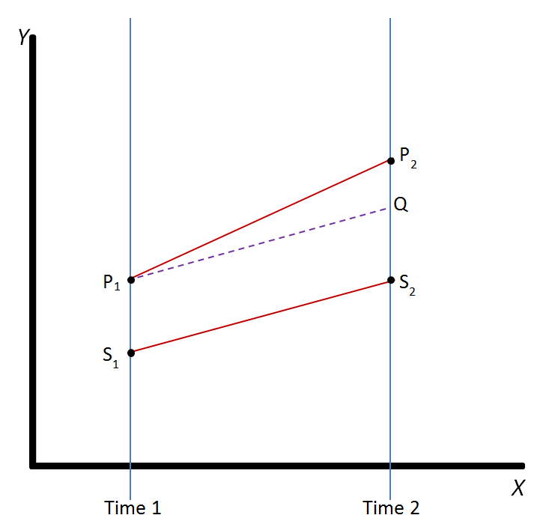
DiD: A particular case of two way fixed effects, D_{i}=1 treated group, D_{t}=1 post treatment, parallel trend β₀₁ common slope: y_{it}=β₀₀+β₁₀D_{i}+β₀₁D_{t}+β₁₁D_{i}D_{t}+ ε_{it}

Slide 3
We pool time series cross section for testing differences (un-pool).
We pool ( =common slope, different intercepts) N time series
To test differences of slopes unpooling in two groups N1+N2=N, N1 with common slope; N2 with common slope (top or bottom cross section quartile = N2 sample).
(more than N1=1 East Germany versus N2=1 West Germany, cf. Abadie synthetic control).
N1 may be close to N2 sample with respect to Z variables using propensity score matching.

Slide 4
Plan (1/2)
Summary: To do list.
Statistical significance and pooling time series.
Definitions
Common slope across individuals
Within vs Between analysis of variance
Growth Aid univariate bivariate analysis

Slide 5
Plan (2/2)
Individual (i) heteroskedasticity: GLS random effects.
Individual (i) endogeneity: IV Mundlak, within, LSDV fixed effects
Between variance and time-invariant variables
Exploratory tools
Growth Aid multivariate analysis
Hausman and Taylor endogenous time-invariant explanatory variables.

Slide 6
1. To do list with panel data

Slide 7
Sections of the To do list (1/2)
1. Data selection N=, T=, check how sample is unbalanced, classify variables by variations with respect to indices. If N<20 and k<T, estimate time series by individuals.
2. Variables transformations (ratios, ln), then between, within, first differences and two way fixed effects.
3. Univariate descriptive statistics, graph, boxplots by individuals, by time, check standardized high leverage observations.
4. Bivariate descriptive statistics, bivariate graphs, check outliers.
5. If T>10, test panel unit root, trend, autocorrelations of variables.

Slide 8
Sections of the To do list (2/2) 6. Estimations
6.1. Static regressions FE, two way FE, First differences.
6.2. If time-invariant variable of interest, Hausman-Taylor or interaction terms.
6.3. Dynamic regressions, First differences, IV First differences (Anderson Hsiaoh) with first stage. But GMM only if T<10.
6.4. Combinations as if DiD: Split into subgroups before/after, for two-way FE with multiple treatments at different dates (De Chaisemartin et d’Haultfoeuille (2022) etc.),
7. Robustness when removing outliers, including vs excluding variables.

Slide 9
1. Small N<20 and k<T=100: Time Series > Fixed Effects.
Run times-series estimations for each individual with DISTINCT SLOPES.
Compare parameters with COMMON SLOPES with fixed effects.
If too much difference across time-series, per all individuals: unless you wish to test differences of parameters, do not pool, stick to time-series. Else poor forecast.
Else POOL individuals with time-series parameters which are not too different.

Slide 10
2. Stata xt
Descriptive statistics:
xtset (define two indices),
xtdescribe, xtsum, xttab, xtdata, xtline, xtunitroot
Regressions:
xtreg be re fe
xtabond2

Slide 11
2. Order your variables with separate univariate statistics
X(it): time and invidual varying.
X(t): only time dependent
X(i): only individual varying (time-invariant).
Do the same if more indices X(itsc):
X(its)

Slide 12
3. Transformations of variables: Between, Within, Two-way Within and First Differences
Never do descriptive statistics on x(it): they are not used by panel estimates. Fixed effects uses x(it)-x(i.).
Compute x(i.); x(it)-x(i.) and x(it)-x(i,t-1)
Separate variables into groups: time-invariant x(i), country-invariant x(t) variables from x(it).
Check data missing per individual for unbalanced panel (xt command).

Slide 13
4. Univariate statistics on x(i.), x(it)-x(i.), x(it)-x(i.)-x(.t)+x(..), x(it)-x(i,t-1)
Do descriptive univariate statistics (min median mean max sigma)
Plot histograms, normal law and kernel and discuss: skewness, outliers, non-normality
Comment and compare discrepancies between versus within distribution.

Slide 14
5. Small N (<50) sample: Within Boxplots by individuals
Plot boxplots per-individuals of x(it)-x(i.).
Compute descriptive statistics by individuals ordered by their standard error.
Comment on individual specific variance and heteroskedasticity: it is also related to the number of observations per-individuals (unbalanced panel).

Slide 15
6. Small T (<50) sample: Within Boxplot across time
Plot boxplots per-year of x(it)-x(i.).
Compute descriptive statistics by dates ordered by their standard error.
Comment on trends or up and downs of standard errors per period.

Slide 16
7. Bivariate statistics for x(i.), x(it)-x(i.), first differences
Correlation matrix also with x(i,t-1)-x(i.)
Matrix of clouds of points
For key explanatory variable of interest and the dependent variable: Bivariate graph with lowess, quadratic and regression line: outliers, non-linear?
Low correlation with dependent, high correlation between regressors: comment

Slide 17
8. xtreg be fe re Mundlak, First-differences
Comment BE, FE, RE, RE with x(i.) (Mundlak), FD regressions and comment.
Report Hausman test: FE > RE
Fixed Effects is your benchmark unless high auto-correlation of dependent and key regressor: x(it)-x(i.) highly correlated with x(i,t-1)-x(i.), Time may be a common trend regressor, unit root even if T small THEN First Differences.

Slide 18
9. Residuals by individuals FE or Mundlak
If N<50, boxplot studentized residuals per individuals: comment on goodness of fit per individuals (heteroscedasticity) and outliers, you may compute RMSE by individuals.
If N>50, compute studentized residuals and collect those over 2 or 3.
If autocorrelation of residuals: xtregar.

Slide 19
10. Your key regressor is time-invariant z(i): Mundlak
Benchmark is Mundlak: RE with x(i.).
Benchmark IS NOT RE (random effects) without x(i.)
Hausman Taylor with internal instruments x(i.) for z(i): xthtaylor

Slide 20
11. Multiple indices with low R2 and low standard error of betas
y(i,t,s,j) = beta. x(s,t,j)
NTSJ observations versus TSJ obs.
x(s,t,j) can’t explain the variance in dimension i. This may imply low R2 and irrelevant (repeated observations) SE(beta).
COMPUTE THE AVERAGE OF THE DEPENDENT with respect to (i) and RUN:
y(.,t,s,j) = beta. x(s,t,j), [increases R2].

Slide 21
12. Combinations by groups with common slopes
Dummies constraining some groups during some periods with common slopes versus some others groups. (cf. diff on diff). THIS IS THE MOST INTERESTING PART.
Interaction terms removes the constraint of identical slopes for all individuals:
(A+B.x(it)) . x’(it)

Slide 22
Fragile/Robust group. Quiet/Crisis; Booms/recessions

Slide 23
Try several combinations of heterogenous groups
Use combinations using different groups for each indices (time and individuals).
Pooling (in panel) widens analysis with respect to time series.
Do not restrict data only to a geographical subgroup. Pool with others for comparison.

Slide 24
Pooling allows Chow (1960) tests of differences between groups and periods
Two groups A and B
cov(X,Y |A) is different from cov(X,Y |B)
With two separate sample regressions,
I obtain two different estimated parameters with two different estimated standard error.
But I cannot test their equality:
The covariance(β1^, β2^) is missing.
You need to pool data of groups A and B.

Slide 25
Dummy(B)*X allows to test directly β(B) = β(A)
Y= β(A).X + β(2). Dummy(B)*X + β0 + ε Dummy(B)=0 (group A, reference).
Y= β(A).X + intercept + β0 + ε .
Dummy(B)=1 (group B).
Y= [β(A)+β(2)].X + β0 + ε
β(2)=β(B)-β(A)
H0: β(2)=β(B)-β(A) = 0 IF β(B) = β(A)
T-stat > 2, reject equality β(B) = β(A)

Slide 26
13. Optional: Other IV methods Lagged dependent Y(i,t-1)
IV for panel (xtivreg)
IF T<10: ANDERSON HSIAOH first differences IV in levels. Panel data GMM first differences (Arellano Bond) (xtabond, xtdpd, Roodman’s xtabond2 ). Panel data GMM system (Arellano Bover): xtdpdsys, xtabond2.
T>10, ANDERSON HSIAOH first differences with IV in levels, two-way fixed effects with IV

Slide 27
14. Optional: Other standard errors and models
xtpcse (pcse)
xtrc (random coefficients)
xtmixed (random fixed coefficients)
xtgls
xtunitroot

Slide 28
15. Statistical significance is not sufficient.
Number of observations NT(SC) is usually very large (>400=20*20).
Check the contribution to R2 (increase of R2 when you add 1 regressor).
Visualize patterns in residuals by individuals (outliers, heterogeneity).
Check near-multicollinearity
Check weak instruments

Slide 29
A. Four problems of the t-tests

Slide 30
Pooling time-series cross section, we expand N times several times series with T observations: this increases a lot t-statistics
Pbm 1: Interpretation mistake
Pbm 2: Multiple testing of “reg monkeys”.
Pbm 3: Substantive versus statistical significance
Intermezzo: what is a good R²? In panel data, it could be very small.
Pbm 4: Editors of academic journals reject papers which do not reject the null hypothesis creates incentives for p-hacking or “publication bias” which is detected in meta-analysis.
Finally, in practice, some tools to learn how to manipulate t-statistics KNOWING why, in addition to the multiple testing of “reg monkeys”.

Slide 31
Problem 1. Conditioning. p(rejecting H₀ with test statistic T>t | H₀ true) < α=5%.

Slide 32
Statistical tests theory versus medical tests, conditional on « true hypothesis»
Given n obs. | H₀ true (healthy) | H₁ true (sick)
T(n)<t: do not reject H₀ Negative medical test | P(T<t | H₀ true) = 1 - (p-value) Cf. specificity. True negative. | P(T<t | H₁ true) =1- P(T>t | H₁ true) = 1 – power = β Type 2 error False negative
T(n)>t: reject H₀ Positive medical test | P(T>t | H₀ true)=α = p-value<5% Type 1 error False positive | P(T>t | H₁ true)=1-β power of the test E.g. power > 80% given p-value<5% Cf. sensitivity True positive
Sum of proba: | 1 (sum of column) | 1 (sum of column)

Slide 33
Statistical tests theory
Student (1908). The probable error of a mean. Biometrika, 1-25. (William Gosset (1876-1937) working in Guinness, Dublin).
Ronald Fisher (1925) Statistical methods for the research worker. Extend Student’s t test and set the 5% threshold: p-value < 5%.
Neyman, J., & Pearson, E. S. (1933). IX. On the problem of the most efficient tests of statistical hypotheses. Philosophical Transactions of the Royal Society of London. Series A, Containing Papers of a Mathematical or Physical Character, 231(694-706), 289-337.
Alternative hypothesis with type 2 error and power. A good test minimize type 2 error (1-Power) subject to a given minimal value of type 1 error (e.g. 5%).

Slide 34
Problem 1: p(H₀ true | test statistic |T|> t_{α} ) < α=5% is WRONG. p(rejecting H₀ if test statistic |T|>t_{α} |H₀ true)< α=5%.
People only say “p-value” but p-value of what?
From some surveys, it could be more than 80% of researchers in a field of research outside statistics, who interpret the p-value of the Student’s test for H₀ : β=0 (no effect) the other way round, because it sounds more “logical” :
p(H₀ true (no effect) | test statistic |T|> t_{α} ) < α=5%
The error is p(A|B) interpreted as p(B|A) or even p(A).
You may use a rule p<5% but you do not understand it during all your professional life as a researcher in a given field. So there is hope for ignorance.

Slide 35
A prior of p(H₀ true) would be necessary for computing p(H₀ true |T>t )
p(H₀ true |T>t )= p(T>t|H₀ true).p(H₀ true )/p(T>t)
With:
p(T>t) = p(T>t | H₀ true). p(H₀ true )
+ p(T>t | H₀ false). (1-p(H₀ true ))
We may have a subjective probability measuring the “prevalence” of the true hypothesis P(H₀ true) for particular cases. A general value for all scientific hypothesis in economics is unknown.

Slide 36
Problem 2: Fishing hypothesis to be tested in the pond of low prior p(H₀ true) for fame.
Some top journals may favour to publish very unexpected hypothesis with very low prior P(H₀ true) just because it is unexpected.
But these are more likely to be sample specific outcomes followed by failed replications.
A controversy following an unexpected result driven by sample specific noise but published in a top journal implies a lot of citations, which is good for a researcher.

Slide 37
Pbm3. Statistical significance for tests of parameters vs substantive significance: Answer: composite hypothesis versus point hypothesis

Slide 38
Standardized variables
The instruction std for STATA transforms the observations of a variable x into the one of the standardized variable:
(x – mean(x)) / standard error (x)

Slide 39
The standardized parameters of a standardized regression
In Stata: Reg, instruction STB « standardized betas » shows the parameters obtained when all (dependent and explanatory) variables are standardized.
Then, we can compare the magnitude of parameters from one explanatory variable to the next one.
With the usual non-standardized parameters, the different standard errors of each explanatory variables implies that their magnitude are not comparable.

Slide 40
Standardized parameters do not depend on sample σ(y) and σ(x)
Simple regression (1 explanatory variable):
β(x)= r(x,y)*σ(y)/ σ(x).
β(standardized)=r(x,y) simple correlation coefficient with | r(x,y) | < 1
Multiple regression: Non standardized estimated parameter (beta) of variable x:
β(x)= β(standardized)* σ(y)/ σ(x).
A sufficiently high correlation between explanatory variables.
⇒ | β(standardized) | < 8

Slide 41


The standardized forecast of a standardized simple regression

Slide 42
The marginal effect interpretation of a standardized simple regression
If (x – mean(x)) / standard error (x) ≤1
⇔ If x deviates from its mean by at most one standard error (of X) (66% of the cases for a normal law)
⇒ (yhat – mean(y))/standard error (y)≤r(y,x)
The forecast of y deviates from its mean by at most the simple correlation coefficient of y and x times the standard error of Y.

Slide 43
Large standardized effect versus large t-statistic
(1) The standardized parameter r(y,x) is large, (but not due to near-multicollinearity in multiple regression for the partial correlation coefficient)
= « substantive significance », Large effect of X on Y.
(2) Large t-stat >2, parameter statistically different from zero at the 5% level, 0 does not belong to the 95% confidence interval
= « statistical significance ».

Slide 44
Substantive significance
Magnitude of standardized coefficient:
A non-significant effect of X on Y:
If the variable X moves from 1 standard error from its mean,
Does the dependent variable Y moves from a tiny proportion of its own standard error from its own mean.

Slide 45
T-stat depends on partial correlation and degrees of freedom
For multiple regression (k>1 explanatory variables, including x and other (k-1) explanatory variables stacked in Z) :
r(y,x|Z)=r(y-Zβ, x-Zβ’ )
Partial (conditional) correlation coefficient. Degrees of freedom are N-k-1.
⇒ For simple regression (k=1, only one explanatory variable x, Z=0): simple correlation coefficient r(x,y), degrees of freedom N-k-1=N-2.

Slide 46
Partial correlation coefficients
r( y , x | Z)=r(y-Zβ, x-Zβ’)
y-Zβ are the residuals of the auxiliary regression of the dependent variable y on the (k-1) other explanatory variables stacked in Z.
x-Zβ’ are the residuals of the auxiliary regression of the explanatory variable x on the (k-1) other explanatory variables stacked in Z.

Slide 47
Particular case: Partial auto-correlation function for an AR(3)
x_{t} = b₁.x_{t-1} + b₂. x_{t-2} +b₃. x_{t-3} + ε_{t,123}
x_{t} = b₄.x_{t-1} + b₅. x_{t-2} + ε_{t,12}
x_{t-3}= b₆.x_{t-1} + b₇. x_{t-2} + ε_{t,3.12}
Corr(ε_{t,12} ,
residuals of the regression of the dependent on the two first lags
ε_{t,3.12} )
residuals of the regression of the 3rd lag on the two first lags

Slide 48
Particular case: Partial auto-correlation AR(2)
If AR(2): x(t)=b1.x(t-1)+b2.x(t-2)+ ε_{it}
Corr( x(t)-b1.x(t-1)-b2.x(t-2) ,
residuals of the regression of the dependent on the two first lags= ε_{it} white noise
x(t-3)-b6.x(t-1)-b7x(t-2) )
residuals of the regression of the 3rd lag on the two first lags
Corr(ε_{it} , x(t-k))=0. When PAC(t-(k+1))=0 not rejected, order k of the AR(k).

Slide 49
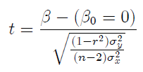
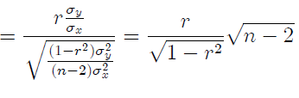

Slide 50



Critical region H₀: r=0 of the t test for n observations.

Slide 51
Pooling increases degrees of freedom
N=25 or T=25 versus NT = 25 x 25.
(1) Multiplies observations by 25:
(2) It divides the estimated standard error of estimated parameters by around 5:
1/square.root(25-k-1) = 1/5
Number of explanatory variables: k
(3) It multiplies the t-stats by around 5

Slide 52
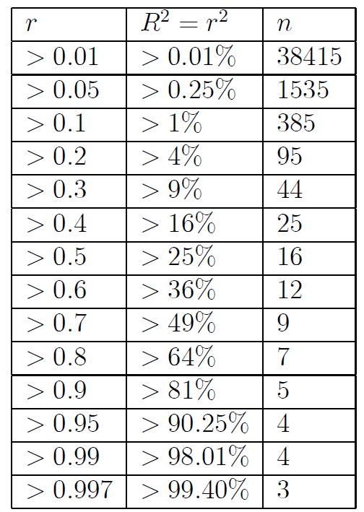

Slide 53
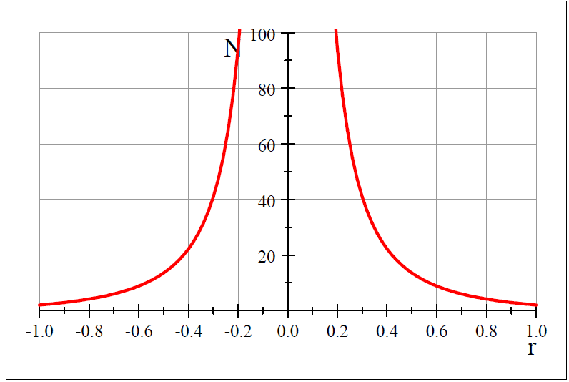

Slide 54
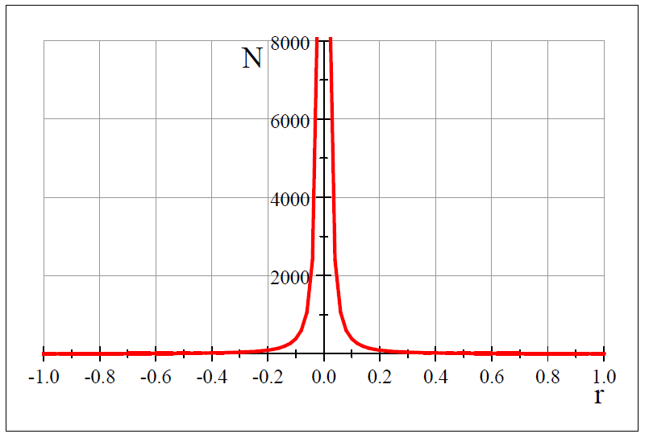

Slide 55
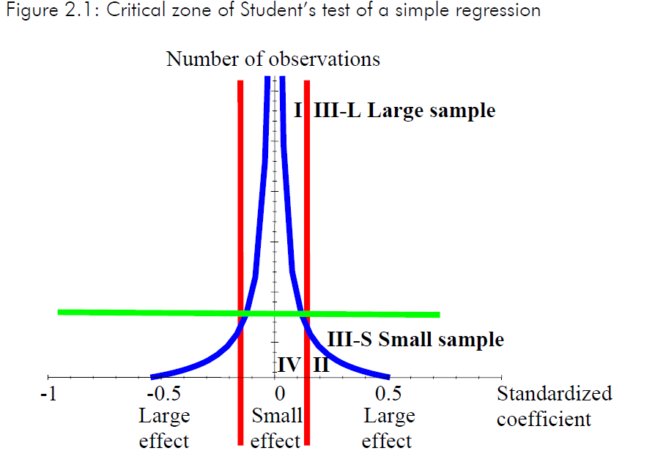

Slide 56
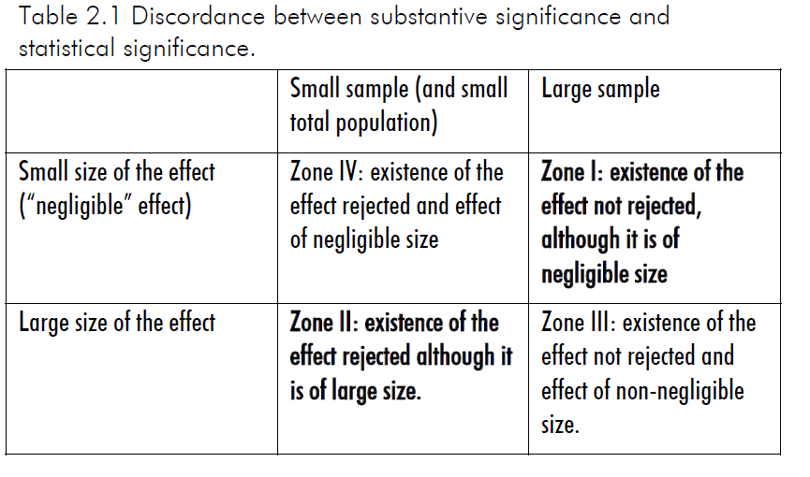

Slide 57
Theoretical answer: Change H0: β = 0 for H0: β < β_{min}
Change the single (on a point) null hypothesis:
H0: β = 0
Which may be infinitely precise: You consider that it matters if:
β = 0 ≠ 0.0000000000001
To a composite null hypothesis, below a treshold corresponding to the « minimal » substantive effect β_{min} with its value derived from a loss function:
H0: β < β_{min}

Slide 58
How to check « substantive significance » for N large?
I have statistical significance at 5% level of one parameter for variable X for N>800.
R2 of the regression excluding the variable X: R2 = 62,51%
R2 of the regression including the variable X: R2 = 62,52%
Gain of R2 including X: +0.01% = too small for substantive significance.

Slide 59
Difference of R2 vs degrees of freedom
The difference of R2 appears as the difference of residuals in Fisher test of the regression.
Along with degrees of freedom.
But if N is large, it turns to be negligible in the overall value of the Fisher test where nearly all the value is driven by N.

Slide 60
Why should I include R² and the number N of observations for each regression at the bottom of a column in a table of my results in my master thesis?
The t-stat > 2 and p-value<5% depends on the square root of the degrees of freedom (N-k-1).
It is not the same to have t>2 for N=1000, N=400 or N=100, because this implies:
⇒ A larger threshold on the partial correlation coefficient (a stronger substantive significance) for N=100 than 400 and than 1000.
⇒ I SHOULD always report N the number of observations used for each regression at the bottom of the table.
R² helps me to gather more information on substantive significance (next slides).

Slide 61
Intermezzo: What is a good « R² » for substantive significance?

Slide 62
Three cases for changing specification, and/or transform variables
First case: R² >98%:
Dependent = explanatory
variables:
Unit root (use first differences as robustness check);
Same item measured on the left hand side and right hand side = think again. Decorrelate them.

Slide 63
2nd: marginal increase of R² too small: R²(y,x,z)-R²(y,z) <1%
First regression includes x and z (« controls ») as regressors.
First regression excludes x and includes z (« controls ») as regressors
This is likely to lead to a partial correlation coefficient (that you can compute with t-stat and degrees of freedom) below 0.1.
This explanatory variable may have a too low standardized coefficient effect.

Slide 64
|r(y,x)|<0.1 and R²=r(y,x)²<0.01 is a small effect
If (x – mean(x)) / standard error (x) ≤1
⇔ If x deviates from its mean by at most one standard error (of X) (66% of the cases for a normal law)
⇒ (yhat – mean(y))/standard error (y)≤r(y,x)
The forecast of y deviates from its mean by at most the 0.1 simple correlation coefficient of y and x times the standard error of Y.

Slide 65
3rd case: R² <2% (and NT>400) often with panel data
Several statistically significant explanatory variables (x) are likely to have a partial correlation coefficient below 0.1, corresponding to
R²(y,x|z)-R²(y,z) <1%.

Slide 66
Too much variance of the dependent?
You have TOO MUCH variance of the dependent variable = do you really need to explain ALL this variance but only a « relevant » proportion of this variance?
Some of this variance may be « noise » or « short term » irrelevant variance with respect to the correlation you seek.

Slide 67
Reduce the variance with a transformation of the dependent f(Y)
Reduce the variance of the dependent:
- Sum with respect to one index which is mostly missing with explanatory variables.
Extreme observations: winsorize or exclude, discretize the dependent into a finite number of categories, smooth or average over time
Use Log, use another denominator for scaling in order to reduce skewness.

Slide 68
Problem 5: Publication Bias with p-hacking Answer: Publish papers who do not reject the null hypothesis of no effect.

Slide 69
Publication Bias p-value hacking
It was not originally designed by Ronald Fisher for his p<5% and t>1.96 rule in the 1930s.
But starting in the 1960s onwards, in several fields of research, in nearly all academic journal, editors reject papers who do not reject the null of an effect.

Slide 70
Wrong incentives
This led to a strong incentive by researchers to manipulate p-values and inflate t statistics
to advance their carreers,
using ingenuity and the versatility of statistical methods,
with the agreement of their pairs.

Slide 71
Theoretical Answer to p-value Hacking
We should publish all the papers, in the best academic journals, which do not reject the null hypothesis of no effect of X on Y
BECAUSE IT IS INFORMATIVE.

Slide 72
Meta-Analysis
In the 1960s onwards, medecine developed meta-analysis.
It collects effects on different population on one variable on another, done in different studies.
It averages the effect across studies (often a boring medium size average, sometimes tending to zero over time).
It sometimes separate effects depending on papers caracteristics.

Slide 73
Funnel plots
One can measure and correct the magnitude of publication bias.
Collecting estimates among different studies and plot their partial correlation values with increasing sample.
With large sample, it is easier to be outside the critical region of the t-stat with lower partial correlation parameter.

Slide 74
Monte-Carlo simulation
One runs a simple regression with standardized bivariate normal distribution variables with a simple correlation of r=0.5 with Monte-Carlo simulations of 100 random draws for each of these four cases: N=50, 100, 150 and 200,
Draw qualitatively what you expect with N on horizontal axis and r on the vertical axis? You may represent normal laws distributions in perspective for four cases: N=50, 100, 150 and 200.

Slide 75
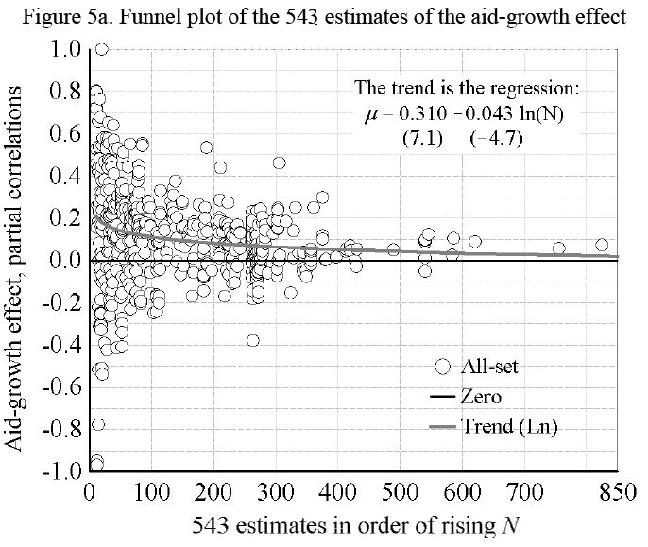
Explain the results of this funnel plot?

Slide 76
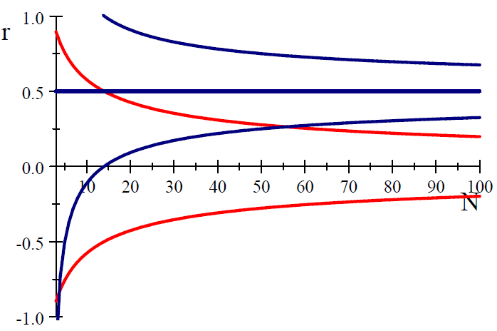
For a true large r=0.5 with 95% of samples in the dark funnel, it is only for N>55 that statistical significance (rejecting r=0 at 5% threshold) is obtained in more than 95% of the samples.

Slide 77
For N=20, the average r=0.4 is necessary so that t=2.
For N=100, the average r=0.2 is necessary so that t=2.
If publication only if t>=2,
this implies researchers’ incentive to bias their selection of samples with multiple testing with trial and errors (see pbm2) outside the red funnel.
This implies the point estimate of the parameter declines with N in meta-analysis.

Slide 79
Estimated standard error of estimated parameter and N-k-1
For a given number of observations N (vertical line), one can visualize the estimated the standard error of estimated parameter.
When N increases, does this estimated standard error of estimated parameter increases or decreases?

Slide 80
Estimated parameter and N-k-1 ?
Econometrics chapter 1 states that:
The expected estimated parameter DOES NOT depend on the number of observations.
The estimated standard error of the estimated parameters should be smaller when the number of observations increases.

Slide 81
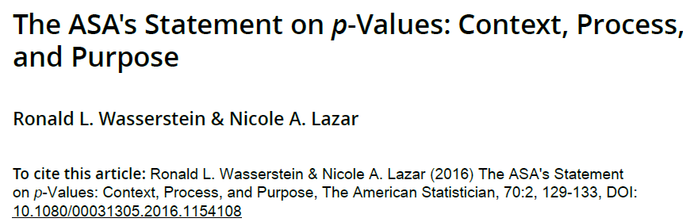
American Statistical Association Statement on p-values (2016).

Slide 82
Problem 4. Multiple testing (multiple comparisons) versus Exploratory data analysis Answer: Bonferroni type correction on the threshold: 5%/number of trials.

Slide 83
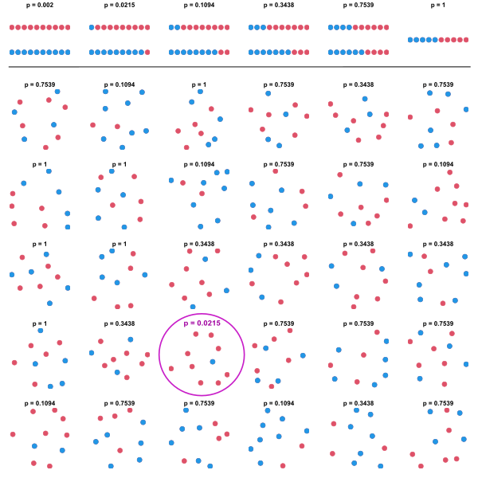
30 independent trials, you may have luck once, « on a misunderstaning »

Slide 84
20 tests = 1 outcome should reject the null whereas the null is not true (5%=1/20).
If one test is performed at the 5% level and the corresponding null hypothesis is true, there is only a 5% risk of incorrectly rejecting the null hypothesis when it is true. This is due to random additive (white noise) disturbances.
However, if 20 independent tests are each conducted at the 5% level and all corresponding null hypotheses are true, the expected number of incorrect rejections (also known as false positives or type I errors) is 1 (1/20=5% threshold) if the tests are statistically independent from each other. If 100 tests, 5 false positive expected.

Slide 85
m=20 different and substitutable explanatory variables measuring “corruption” = m = 20 tests
Proba of type I error:
p(rejecting H₀ with test statistic |T|>t_{α} |H₀ true) = α
No error: p(not rejecting H₀ with test statistic |T|>t_{α} |H₀ true) = 1-α
Proba of no error in m independent tests = (1-α)^{m}
Proba of at least one error in m independent tests (also called family wise error rate).
= 1 - (1-α)^{m} = 1 - (1-mα)=mα < 5% arbitrary threshold
First order Taylor expansion for small α
Then the threshold per-test should DECREASE with the number of trials:
α < 5%/m. For 5 trials 5%/5=1%.
This is called Bonferroni correction. It is done in genetics, not in economics.

Slide 86
Trade-off: p-value<5% or explorations of the data set properties?
Should we stick to only 1 regression and 1 single test?
But we learn from exploratory data analysis, with trial and errors, with 20 to 40 regressions.
The more we learn with multiple testing, the less valid is the 5% threshold and t-test>2, p-value<5%.
In this case, what matters is your path exploring the data, extracting signal from noise, not the final outcome leading to t>2, which turns to be irrelevant.

Slide 87
Part A: Conclusion. p-hacking: Some of the tricks

Slide 88
How researchers increase t-stats
t-stats increases with the number of observations and with the partial correlation coefficient.
Expand the number of observations up to at least 400 but why not 5 millions.
Expand the partial correlation coefficient by selecting observations, by selecting variables, by transformation of variables, by selecting estimators.

Slide 89
Observations: scientific approach to boost your parameter
For each observations, you have an influence statistics for regression called df-beta: it signals if this observations increases (if positive) or decreases the estimated parameter (numerator of t-stats).
If you wish a positive beta, you remove one by one the lowest negative until the t-stat >2.
You may also code a df-tstat: by how much a t-stat increases when you remove each observations in the sample. From the lowest negative to highest positive.

Slide 90
Selecting observations: do it yourself with trial and errors
Sample selection biases: Survivorship bias,
Omitting weak individuals not reported by statistical offices.
This may be coupled with adding variables with many omitted observations. It is not your fault, it is the statistical office and else, the other variable leads to an “omitted variable bias”. You add this variable in the regression, but you lose 400 observations over 800.
Selecting outliers: keep high “positive” influence outliers with dfbeta>0 if you seek positive effect while being strict on a few “negative” outliers. The effect is true but on a few individual, you publish an erroneous inference: it is true on the majority of the population.

Slide 91
Adding highly correlated variables: squares, interaction terms, lags, etc.
These specifications are interesting: non-linear, complementarity, dynamic model.
If near-zero effect before including the highly collinear variable, after inclusion, the t-stat may shift from below 2 to over 2.

Slide 92
Multiple testing of 20 variable measurements of the same item.
For example “20 good governance indicators” including some noise related to experts views.
By sampling errors, you would have 1 chance of 20 to get t-stat >2.
You do not report (no-one does in economics so far) how many trials you have done.
You report only 1 case with t>2 and not the 19 other trials with t<2.

Slide 93
A clever trick with IV estimator and weak instrumental variables
Y= β₁ x₁ + β₂ x₂ + ε
In the first stage of instrumental variables, the first explanatory variable x₁ is explained by the second one x₂ (moderately correlated, 0.4) and an instrument z which is weakly correlated (0.05) with x₁. Then the forecast replacing x₁ used in the second stage is mostly driven by x₂. It is now highly correlated with x₂ (>0.8) so that its second stage IV parameter β_{1,IV} expands, t-stat increases, with a sign flip. What is more, Hausman test statistics increases due to the increase of the IV parameter with respect to OLS (β_{1,IV} - β_{1,OLS}) so that it confirms IV should be preferred to OLS. But the tests of weak instruments would infirm this success.

Slide 94
Master thesis
For master thesis, we do not ask for t>2 for a good grade.
You may actually try up to 50 or 200 trials of various kinds when exploring the data of your master thesis. The marginal cost of a trial in terms of time is small.

Slide 95
1. Definitions

Slide 96
Data with multiple indices: X(i,j,r(i),r(j),s,t)
Export, Foreign direct investment, capital flows, credit, etc from
COUNTRY (or BANK): index i
COUNTRY (or FIRMS): index j
SECTOR: index s
REGION within a country i : index r(i)
TIME (with different frequency) : index t

Slide 97
Benchmark case X(i,t) Time-series cross-section: TSCS
N Individuals (macro: country; micro: firm, households, banks): index i
With REPEATED observations over time during T periods:
With frequency: intraday, daily, monthly, quarterly, yearly, every four years.

Slide 98
Panel Data sets. (GMM: generalized method of moments for dynamic panel data).
 | Small T: 20<100 If T<10: GMM doable. | Large T : 1000>100 Panel data unit root test, cointegration.
Small N : 20<100 | Macro, OECD. Check by country estimates. | Market finance
Large N: 1000>100 | Firms and banks balance sheets, surveys. | Market finance

Slide 99
Minimal panel data set NT = 2 x 2 = 4
Variable X
Observed at least for
N = 2 individuals
Over the SAME two periods
T = 2 periods.
Number of observations =
N x T = 2 x 2 = 4

Slide 100
Minimal panel data set N=2 (ident), T=2 (year)
IDENT | YEAR | X(it) | X(i.) | X(it)-X(i.)
1 | 1 | 8 | 10 | -2
1 | 2 | 12 | 10 | +2
2 | 1 | 5 | 4 | +1
2 | 2 | 3 | 4 | -1
ID=1 | Mean | 10 | 10 | 0
ID=2 | Mean | 4 | 4 | 0
All | Mean | 7 | 7 | 0

Slide 101
Event studies, Fragile/Robust group. Quiet/Crisis; Booms/recessions

Slide 102
Panel data
You POOL time series with T observations of N individuals
You POOL cross sections of N individuals during T periods.

Slide 103
Organizing the database
Usual coding difficulty
You download data:
Column 1 is X(1,t) AND column 2 is X(2, t)
You need to code to have 1 single column for two individuals where the data of column 2 is BELOW column 1
For the single variable X(i,t).

Slide 104
2 indices: ident and year. « xt » data set.
OBS ident year country country3 countryyear gdpg gdp
1. 2 2 ALGERIA DZA DZA2 2.386264938 1826
2. 2 3 ALGERIA DZA DZA3 3.236683588 2256
3. 5 2 ARGENTINA ARG ARG2 1.70029991 5637
4. 5 3 ARGENTINA ARG ARG3 1.07761478 6168
5. 5 4 ARGENTINA ARG ARG4 -1.115284993 5849
6. 5 5 ARGENTINA ARG ARG5 -2.551384576 5487
7. 5 6 ARGENTINA ARG ARG6 -1.099306164 5624

Slide 105
Data set by year: unbalanced?
. * PROC FREQ: number of countries per periods
. tabulate year
year | Freq. Percent Cum.
------------+-----------------------------------
2 | 41 14.91 14.91
3 | 47 17.09 32.00
4 | 48 17.45 49.45
5 | 48 17.45 66.91
6 | 49 17.82 84.73
7 | 42 15.27 100.00
------------+-----------------------------------
Total | 275 100.00

Slide 106
Balanced or unbalanced panel
N>2 and T>2
If ALL individuals have observations for ALL periods, the panel is BALANCED.
If at least one individual has one observation in time missing: the panel is UNBALANCED.

Slide 107
Signal your software: columns are sorted by indices: ident year
sort ident year
xtset ident year
xtdescribe

Slide 108
UNBALANCED PANEL DATA SET: 56 COUNTRIES, 6 PERIODS OF 4 YEARS AT MOST.
Freq. Percent Cum. | Pattern
-------------------------+-------
34 60.71 60.71 | 111111
3 5.36 66.07 | 11111.
2 3.57 69.64 | ...11.
2 3.57 73.21 | ...111
2 3.57 76.79 | .11...
2 3.57 80.36 | .11111
1 1.79 82.14 | .....1
1 1.79 83.93 | ....1.
1 1.79 85.71 | ..1...
8 14.29 100.00 | (other patterns)
---------------------------+------
56 100.00

Slide 109
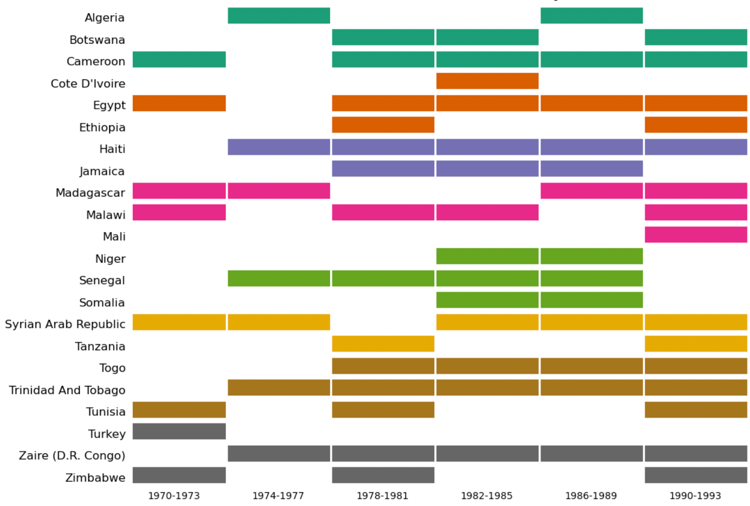

Slide 110
Single column X(i,t) Lag operator does not work
Once you have a single column for all individuals: This is STACKED time series.
You need to have special code for the LAG operator: why? Try a 2x2 example.
Example stata: xt command for all panel data instructions

Slide 111
Lag and Dif operator: requires mentioning two indices
Ident | Year | X(it) | Lag(X(t)) time series | Lag(X(it)) =X(i,t-1) Stacked Panel
1 | 1 | 8 | Dot (not available). | Dot (not available)
1 | 2 | 12 | 8 | 8
2 | 1 | 5 | 12 | Dot (not available)
2 | 2 | 3 | 5 | 5

Slide 112
Minimal panel data set N=2 (ident), T=2 (year)
IDENT | YEAR | X(it) | X(i.) | X(it)-X(i.)
1 | 1 | 8 | 10 | -2
1 | 2 | 12 | 10 | +2
2 | 1 | 5 | 4 | +1
2 | 2 | 3 | 4 | -1
ID=1 | Mean | 10 | 10 | 0
ID=2 | Mean | 4 | 4 | 0
All | Mean | 7 | 7 | 0

Slide 113
Descriptives statistics
Always separate explicitly your variables:
X(i,t)
Z(i)
Z(t)
Do the same for X(i,j,r,s,t) and X(i,j) and any combinations of selecting k indices among a total (here of 5).

Slide 114
NT = 5x20 = 100 is NOT like T = 100 time series OR N = 100, cross-section.
Within between decomposition.
Autocorrelation with T, not with N.
Individual i is NOT the « continuation » of individual j « at a later or earlier stage ».
Common time series and time-invariant variables: specific inference with N or T, but not with NT.

Slide 115
The case of X(i,j,t,…) at least three indices
Credit from bank(i) to firm(j)
Flows from country(i) to country(j):
Goods: exports, imports.
Capital: foreign direct investment, equity, debt, foreign aid, remittances, cash.
Labour: migration, tourism.

Slide 116
Fixed effects dummies
Single index dummies:
Z(i)=Z(j): individual fixed effects
Z(t): time fixed effects
Dyads (two indices) dummies:
Z(i,j): all time-invariant « gravity » geographical distance and other variables.
Z(i,t): all country of origin time series
Z(j,t): all country of arrival time series

Slide 117
Remaining variance explained only by X(i,j,t) variables
Other flow variables: X(i,j,t)
Time-varying Interaction terms (product of) variables for pair of countries: X(i,t)*X(j,t)
Time-varying Differentials between each countries (growth, taxation, regulation,…): X(i,t) – X(j,t)

Slide 118
Classify your variables by number of indices
When one index among (i,j,t,s) is shut down for an explanatory variable (e.g. X(i,ts)), this variable does not vary with respect to this missing index (j).
Therefore it cannot explain the variance of the dependent variable Y(i,j,t,s) related to this index (j).

Slide 119
Classify your variables according to their indices
In descriptive statistics and regressions order them by their number of indices:
Y(i,j,t)
X(i,j,t)
X(i,j), X(i,t), X(j,t)
X(i), X(j), X(t)

Slide 120
2. The unpleasant Fisher pre-test of poolability assuming common slopes for all (or subgroups of) individuals.

Slide 121
History
Ronald Fisher proposed a test of poolability (with common slopes, with distinct intercepts) that he labelled analysis of the covariance (ANCOVA) in the 1930s.
Kuh (1963) framed these tests testing investment equations using panel data.
Hsiao (1983) copied Kuh (1963) framework in his textbook.

Slide 122
TO DO. Small N<20 and k<T Compare with time series estimations
Run times-series estimations for each individual.
Compare parameters with common slopes with fixed effects.
If too much difference per time-series, per all individuals: stick to time-series.
Pull some individuals with time-series parameters which are not too different.

Slide 123
Fixed effects or Within estimator Common slopes, Distinct intercepts
Panel data estimator (random effects and fixed effects) both allows for individual specific intercepts or individual specific means of random effect.
Panel data estimators differ from time series estimations BY individual, in assuming the SAME slopes parameters for all individual (except for the intercepts for fixed effects).

Slide 124
Baltagi Griffin (1983): Gasoline demand
Type of sample: square panel N and T around 20x20: Yearly data of OECD countries, 1960-1978.
N=18 T=19 k=3 Time series estimation feasible but poor degrees of freedom: T-k-1=15
Degrees of freedom pooled OLS
NT-k-1 = 342 – 4 = 338
Next slide: subsets of table 1 and table 2

Slide 125
Specification of the model with near-multicollinearity due to common trend
Ln(Gasoline /Car) _{it} =
β₁ .Ln(GDP /population) _{it} +
β₂ .Ln(price gasoline /consumer price index) _{it}
+ β₃ .Ln(Car/population _{it})
+ β₀ (common intercept here)
+ α_{i} + α_{t} + ε_{it} (ALWAYS write these three disturbances with indices for your panel data model).
Panel estimators are restricted OLS, setting at least the restriction that the slope parameters are the same across individuals (countries).

Slide 126
The specification and the transformations of variables is strategic: it drives the results
(1) Common deterministic trend for GDP/population and Car/population during 1960-1978 in OECD countries ⇒ high simple correlation.
(2) Negative correlation if one variable is at the numerator of a ratio and if the second ratio as this variable at the denominator =
A researcher-built-in TRANSFORMATION of variables as ratios with DIFFERENT denominators creates an ad hoc strong correlation.
(3) A published paper reproduced in textbooks as an good example may not have a good specification. For empirical work, NO authority argument is valid. Only the replication to check its robustness matters.

Slide 127
Endogeneity issue: The demand for cars depends on income and relative price
Ln(Car/Population) =
β₁ .Ln(GDP/population)
β₂ .Ln(price cars/consumer price index)
+ β₀
+ α_{i} + α_{t} + ε_{it}
Logistic diffusion curve for the demand of cars with households equipment during 1960-1978, in the middle of the logistic curve.

Slide 128
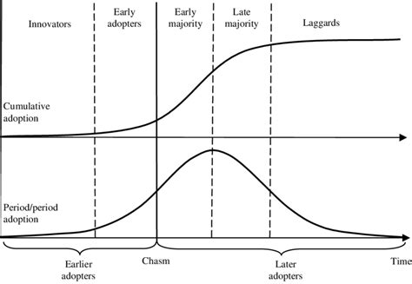
Diffusion curve for technology adoption (Logistic function also used as F (cdf) in the Logit model)

Slide 129
Better specification of the model, not used in the published paper (and use instrumental variables)
Ln(Gasoline/Population) =
β₁ .Ln(GDP/population) +
β₂ .Ln(price gasoline/consumer price index)
+ β₃ .Ln(Car/Population)
+ β₀
+ α_{i} + α_{t} + ε_{it}
Ratios where you divide by the SAME denominator.
It turns to have comparable estimates in within (fixed effect) and between (average of cross section) estimators, which is rare and signals consistency.

Slide 130
Near multicollinearity with small degrees of freedom (sample)
With small samples and many explanatory variables: small degrees of freedom:
N-k-1 <20
Near-multicollinearity problems are more likely to arise, with over-fitting, unstable parameters (removing or not a few observations), being too large with one of the two (or more) parameters with unexpected signs: check the sign of the income effect,

Slide 131
Degrees of freedom DOFNext slide: subsets of table 1 and table 2
Balanced sample, yearly frequency, N=18 OECD countries, T=19 years, from 1960 to 1978, k=3 explanatory variables and one intercept (18 intercepts for fixed effects). Time series estimation by country:
DOF = T-k-1=19-3-1=15
Between: transformation is the average « of cross sections » over time for each variable:
DOF=N-k-1=18-3-1=14
Pooled OLS and random effects GLS:
DOF=NT-k-1 intercept = 342 – 4 = 338
One way within = Fixed effects least square dummy variables
with N=18 intercepts for each of the 18 countries.
DOF=NT-k-N intercepts = 342-3-18= 321.

Slide 132
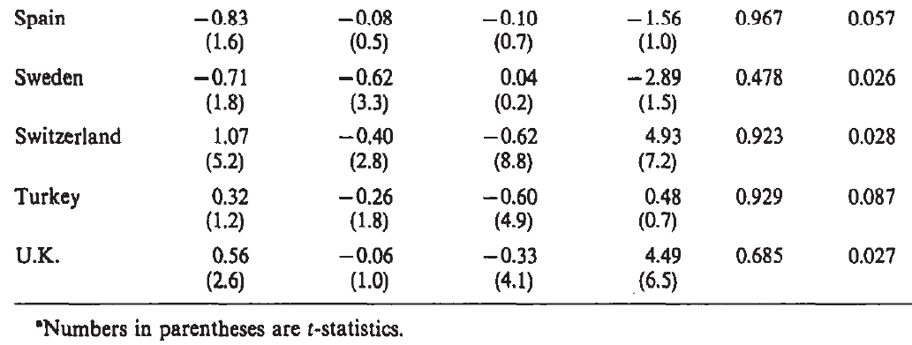
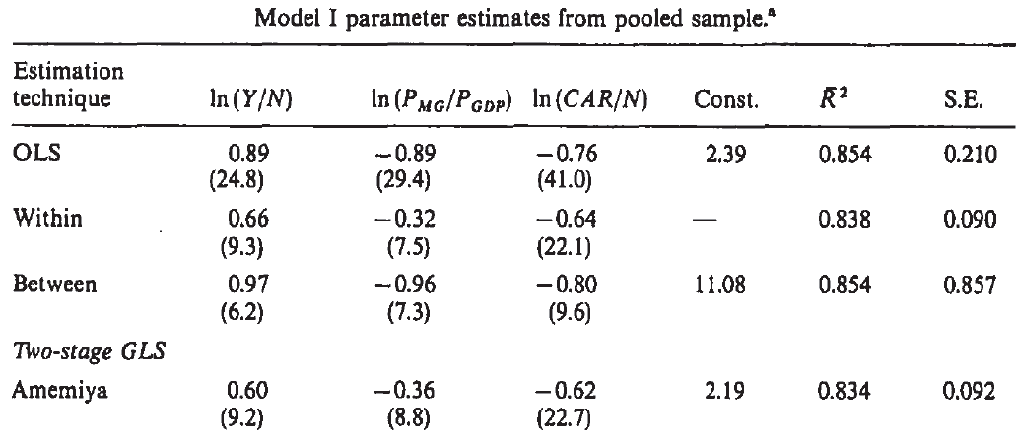

Slide 133
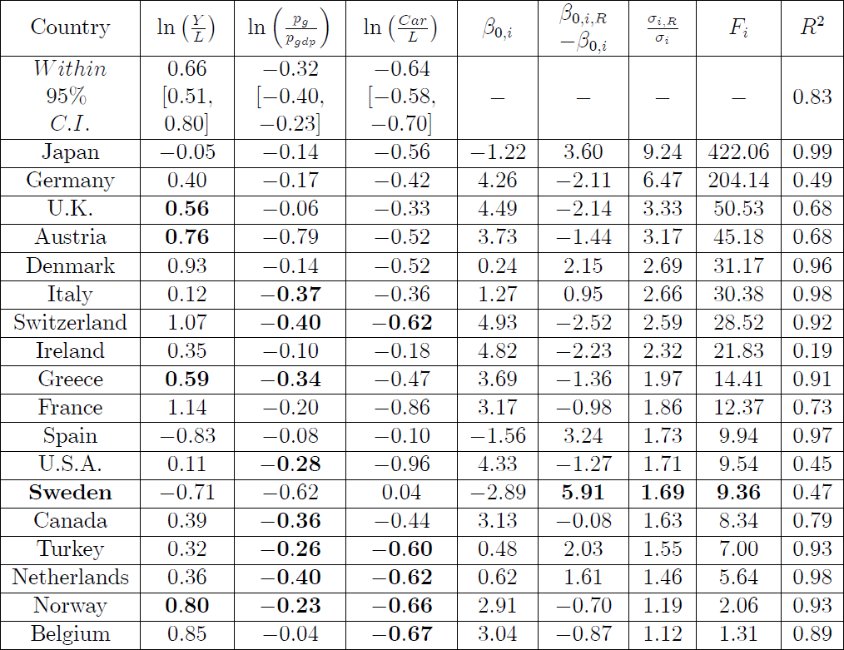

Slide 134
Questions on the previous tables
Compare parameters: does it make sense to pool? Which countries may be pooled?
Values of t stat and statistical significance: pooled versus pooled.
Ratio of RMSE (SE) reported to average RMSE by country for time series?
Why no « constant » for within?
Why between distinct from within estimates?
Within (fixed effects) close to (random effects) GLS?

Slide 135
Panel estimators are « restricted » OLS estimators
Panel estimators are restricted OLS, setting at least the restriction that the slope parameters are the same across individuals (countries)
β₁ = β_{1,USA} = β_{1,SWEDEN} = … = β_{1,SPAIN}
In differences in differences, you assume that for each of observations WITHIN each of the FOUR sub-groups (treated vs non treated, before vs after) have the same slope.

Slide 136
Restricted OLS ⇒ SSR increases ⇒ poorer forecast properties.
In the general case, when one assumes a (coded in softwares: linear) restriction on some parameters, this restricted regression is no longer minimising the sum of squares of the residuals (SSR) as done by the usual unrestricted regression.
⇒ The sum of squares of residuals and its root (RMSE) are LARGER with the restricted regression with respect to the unrestricted
⇒ The forecast properties are worse for the restricted regression.

Slide 137
When you pool N time series of T observations, degrees of freedom increases widely: NT-k-N (fixed effects, N intercepts) > T-k-1 (time series of one individual, 1 intercept)
⇒ A sharp increase of the square root of degrees for freedom, at the denominator of:
⇒ A sharp decrease of the estimated standard error of the estimated parmeters, at the denominator of t statistics
⇒ A sharp increase of t-statistics with increase with the square root of degrees of freedom.
⇒ Much more chances to have t>2 and p<5% and statistical significance for your parameters of interest.
⇒ More chances to publish your paper, because of publication bias.

Slide 138
Critical region H0: r=0 of the t test for n observations.

Slide 139
Obtain statistical significance outside the funnel given unchanged partial correlation r for all individuals NT-k-N (fixed effects) ≥ 1.96(1-r²)/r² ≥ T-k-1 (time series)

Slide 140
Panel data common slope assumption and near-multicollinearity
Near-multicollinearity (high correlation between variables) will remain in some panel data estimators.
However the common slope assumption leads to parameters which are a weighted average of time-series estimations by individuals.
Therefore, they have a chance to look « more reasonable » (closer to expected values) in terms of signs and magnitude than the estimates of time-series.

Slide 141
The common slope restriction ⇒ a bias on intercepts estimates by individual in fixed effects model.
The best linear unbiased estimates of intercepts for each individual (also called fixed effects) are the intercepts found by the unrestricted time series by country estimates.
⇒ the panel data estimators of intercepts are biased due to the spillovers of the common slope restriction
⇒ Never spend time discussing the interpretation of “fixed effects” intercepts using panel data estimators. You may not report them as on this table: Within estimations line: the symbol – for the intercept: there are in fact N=18 different intercepts of each country.

Slide 142
Times series VERSUS panel estimators common slopes VERSUS pooled OLS
Per country time series equations
y_{i=1,t} = β_{0,i=1}+ β_{x,i=1} .x_{i=1,t}+α _{i=1}+α _{t}+ε_{i=1,t}
y_{i=2,t} = β_{0,i=2} + β_{x,i=2} .x_{i=2,t} +α_{i=2}+α _{t}+ε_{i=2,t}
Fixed effect (Within), Random effects and Between estimators assumes the restriction of common slopes: β_{x, i=1} = β_{x, i=2} ,
Pooled OLS also assumes common intercepts: β_{0, i=1} = β_{0, i=2} .

Slide 143
Residuals by individuals, next three slides
Estimations | Slopes: for each explanatory variable | Intercepts
Time series for each individual or seemingly unrelated regression estimator of a system of equations. | N estimated parameters Specific to each individual | N estimated parameters specific to each individual
Pooled OLS: too many restrictions: do not report this estimation. | Restriction: 1 single parameter common to all individuals | Restriction: 1 single parameter common to all individuals
Fixed effects | Restriction: 1 single parameter common to all individuals | NO restriction N estimated parameters specific to each individual

Slide 144
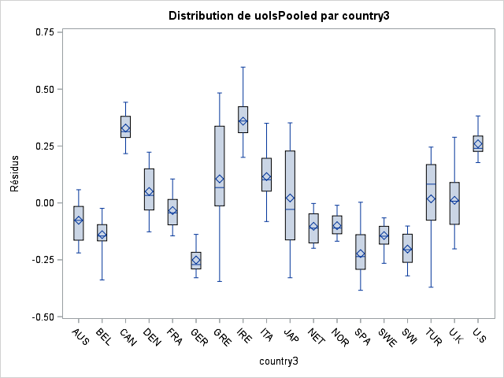
Pooled OLS residuals by country Common slopes, common intercepts

Slide 145
Comments on pooled OLS residual by country
The mean of all residuals is ZERO, as soon as there is an intercept in the regression.
The means of residuals for each country is NOT zero. A mixture of distribution implies non normality.
Skewness of some distributions by country implies non-normality.
Large differences of standard errors by country (Hetero-scedasticity by country).
Range of extreme values: -0.3 to 0.6. A plot of studentized residuals would have highlighted residual outliers outside [-2,+2].

Slide 146
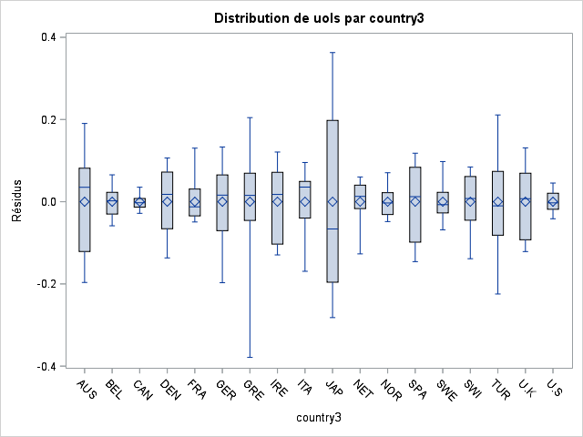
Fixed effects = Within residuals Common slopes, distinct intercepts

Slide 147
Comments on Fixed Effects or Within residuals by country
The mean of all residuals is ZERO, as soon as there is an intercept in the regression.
The means of residuals for each country is zero. The intercepts by country picked the means of residuals by country of pooled OLS.
Skewness of some distributions (mean different from median) by country implies non-normality.
Large differences of standard errors by country (Hetero-scedasticity by country).
Range of extreme values: -0.4 to 0.3. A plot of studentized residuals would have highlighted residual outliers outside [-2,+2].

Slide 149
Visual conclusion: Do not waste time, NEVER REPORT POOLED OLS
It is a disaster with too many restrictions.
Report instead:
One-way fixed effects (dummy for individuals)
Two-way fixed effects (dummy for individuals and periods)
First differences
And other instrumental variables of these models, and diff and diff, and so on.

Slide 150
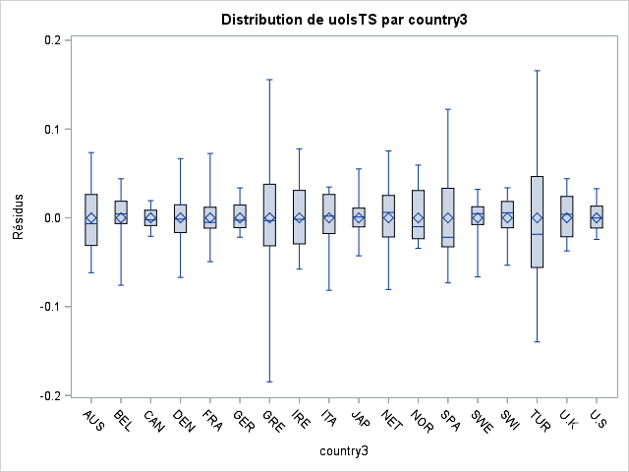
Time series residuals by country Distinct slopes, distinct intercepts

Slide 151
Time Series by country residuals by country
The mean of all residuals is ZERO, as soon as there is an intercept in each regression.
The means of residuals for each country is zero. The intercepts by country « captured » the means of residuals by country of pooled OLS but are DIFFERENT for intercepts estimates by Fixed effects.
Skewness of some distributions (mean different from median) by country implies non-normality.
Large differences of standard errors by country (Hetero-scedasticity by country).
SMALLER range of extreme values: -0.2 to 0.2. A plot of studentized residuals would have highlighted residual outliers outside [-2,+2].

Slide 153
Visual conclusion: if T>80 and N<20: Stick to time series instead of panel.
You avoid the bias of the intercept and the increase of the Sum of Squares of the Residuals.
UNLESS you manage to find:
(1) 4 subgroups (treated vs not treated / before after an event) with slope parameters not too far away:
(2) A common trend for treated/not treated.
In order to apply « diff and diff ».

Slide 154
Common slopes estimate
For pooled OLS,
Within-fixed effects or
Generalized Least Squares (GLS)-random effects:
The common slope estimate is a weighted average of time-series slopes by individuals,
With different weigths depending on estimators.

Slide 155
Investigating into details the consequences of common slopes
We can find mathematically:
How much the intercepts are biased.
How much the sum of squares of residuals are increased, country by country.
Then, we can better understand the Fisher test of poolability: this test is very rarely shown, because it usually rejects the null hypothesis of common slopes.

Slide 157
Table: Within (common slopes, different intercepts) versus (different slopes and intercepts)
Contrast confidence interval for common slopes versus time series.
Contrast intercept estimates for fixed effects versus time series.
Contrast RMSE (restricted SSR) for fixed effects versus time-series,
Chow (1960) or Fisher ANCOVA test (1936) of poolability: Kuh (1963) copied in Hsiaoh (1986) textbook.

Slide 158
(1) Within (common slopes, different intercepts) slopes confidence interval versus (different slopes and intercepts)
3 columns for slope parameters: common (within=fixed effects) versus time-series country specific with very NARROW confidence interval:
For ln(Y/L): the estimates (in bold) of 4 countries over 18 are in the confidence interval (95%), instead of around 17/18 expected (19/20 = 95%).
For ln(pg/cpi): 8 countries over 18 estimate in the confidence interval (95%), instead of 17 expected.
For ln(car/L): 5 countries over 18 estimate in the confidence interval (95%), instead of 17 expected.

Slide 159
2. Intercept estimates bias.
The unbiased « fixed effects » estimates of intercepts are the ones of time-series not of « fixed effects ».
The bias due to the « report » of the constant slope constraints on the intercept is large upwards and downwards: largest bias : Sweden= -2.8 unbiased, biased: -2.8+5.9=+3: Forget any interpretation of « fixed effects » with such a bias (and remove near-multicollinearity first in the specification).

Slide 160
Restricting the slopes to be the same when they are different
β_{x,i=1, time series}
< β _{x,panel fixed effects}
= w₁. β_{x,i=1, time series} + (1-w₁). β_{x,i=2, time series}
< β_{x,i=2, time series}

Slide 161
For fixed effects with individual intercepts
Spillover of the common slope restriction for variable x which adds on the intercept:
(β_{x,i=1, time series} - β _{x,panel fixed effects} )*x_{i=1,.}
x_{i=1,.} reads « x (i, dot) ». This NOTATION is the average of the observations of the variable x for the individual i=1, or the BETWEEN transformation of the variable x.

Slide 162
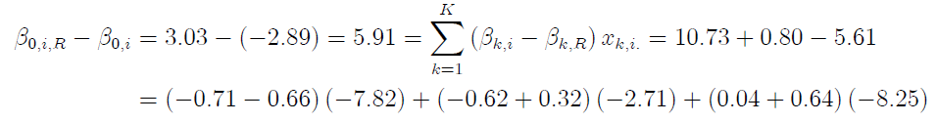
Bias of the « fixed effects » intercept estimate for Sweden

Slide 163
Interpretation of fixed effects
The « fixed effects » model is NOT GOOD for estimating « fixed effects » (intercepts for each individuals) with respect to un-pooled time series intercepts.
The genuine fixed effect is the intercept of time series, without the identical slopes restriction.
This fixed effect captures ALL the unmeasured characteristics of the individual which did not vary over time during the period of the sample that have an effect on the dependent variable.

Slide 164
Interpretation of the « fixed effects » intercepts of the fixed effects estimator
This fixed effect captures ALL the unmeasured characteristics of the individual which did not vary over time during the period of the sample.
PLUS the sum for each explanatory variable x of all the terms due to the common slope constraints:
(β(x,i)-β(x,panel))*x(i.)

Slide 165
Interpretation of fixed effects: cross section< panel data <time series
Fixed effect captures ALL the unmeasured (OMITTED) characteristics of the individual which did not vary over time during the period of the sample. This is true with respect to a cross section.
But a time series estimation does it much more precisely, so that capturing all omitted time-invariant characteristics (« UNOBSERVED HETEROGENEITY ») is NOT a benefit of panel data with respect to time-series.

Slide 166
3. Bias increasing the restricted SSR with respect to unrestricted SSR
6th column: ratio of RMSE (square root of the sum of square of residuals SSR) constrained versus unconstrained > +45% but for two countries.
Record: multiplied by 9 for Japan.

Slide 167
Countries sorted by RSSR/SSR in this table.
Whenever you can in tables or graphs, avoid to present observations sorted in alphabetic order or any other exogenous order.
Sort your observations data by a key variable of interest.

Slide 168
For fixed effects with individual intercepts
What has gone into the residuals is for EACH of the three explanatory variables x:
(β(x,i)-β(x,panel))*(x(it)-x(i.))
The individual mean over time is different of zero:
(β(x,i)-β(x,panel))*(x(i.)-x(i.)) is zero.
So that the individual residuals do have a mean of zero, as well as the sum of ALL residuals for ALL individuals is zero.

Slide 169
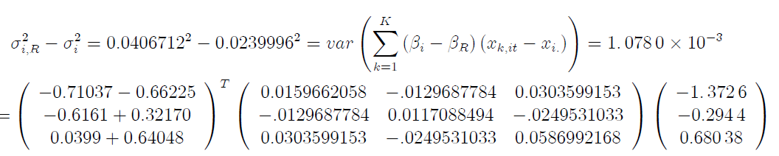
Bias of the restricted variance of residuals (RMSE) due to common slope restriction

Slide 170
4. Poolability F-tests cf. F-test for restrictions on parameters
F-tests include the difference between the sum of squares of residuals (with restriction of equality of slopes) less without restriction, divided by the sum of squares.
JBC-KR propose to split F-tests by individuals, and then pool together homogeneous for a F-test including a sub-group. This is related to the ratio of standard error of residuals with restriction/without.

Slide 171
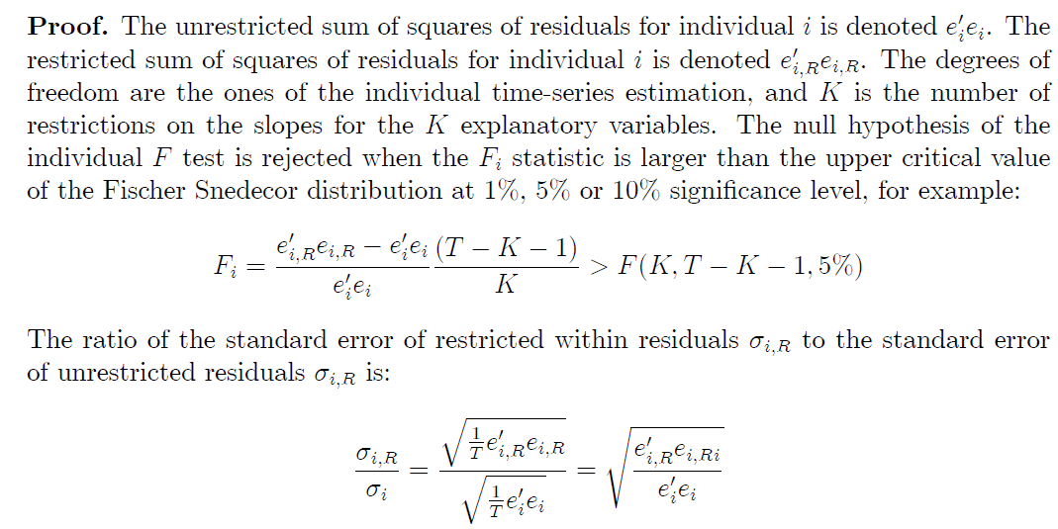
« Individual » F test

Slide 172
Table
7th column: value of F(i) statistics, increasing function of the ratio of
SSR(restricted)/SSR(unrestricted).
8th: R2 of time series regression for each country.

Slide 173
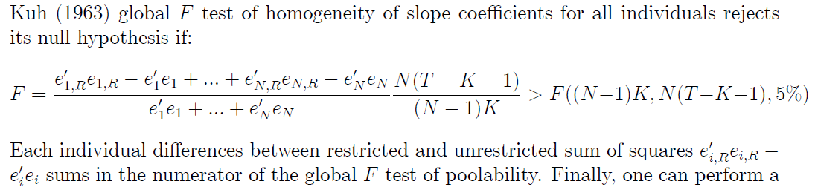
Usual Global F test (Kuh (1963)). (Hsiaoh (1986)).

Slide 174
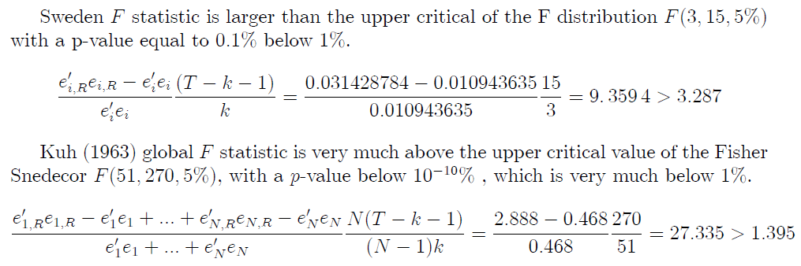
P-value<<5%, (result published in 1983). Reject the null hypothesis of common slope

Slide 175
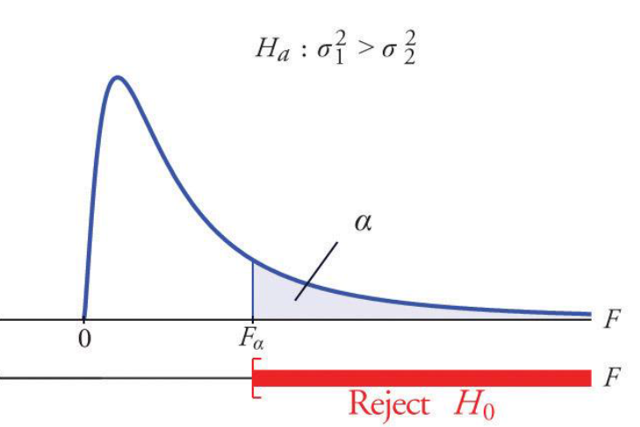
H0: Equal variances, Ha: RSSR>SSR F(5%) = 1.39 <<< F = 27.33

Slide 176
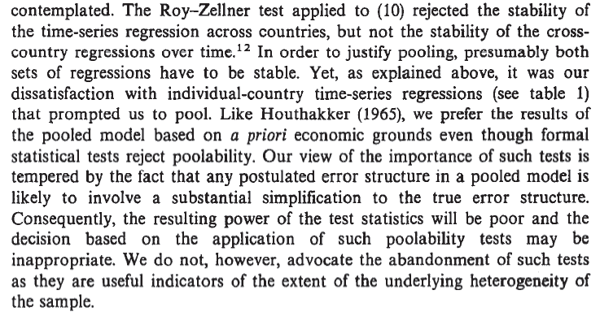
Baltagi (1983), « even though » the high power of the test F=27.33, p=10⁻¹⁰<5%

Slide 177
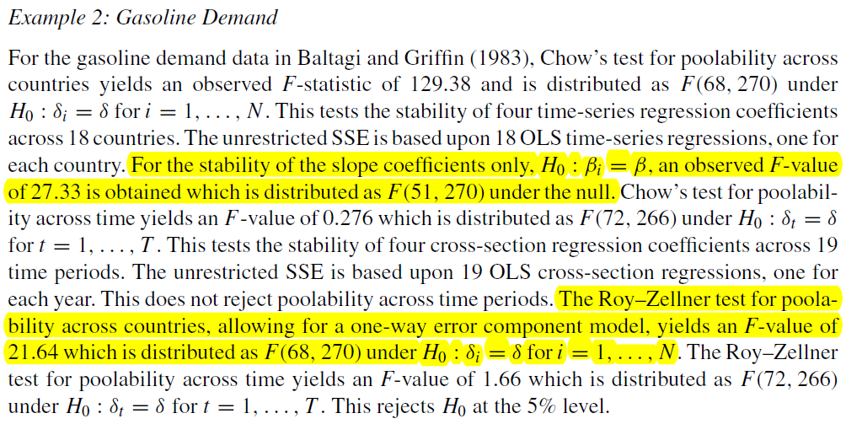
Baltagi (2005) textbook, see also updated editions

Slide 178
Following the rejection of the null hypothesis of common slopes
At least three alternatives:
Change specification: in this example, avoid near-multi-colinearity of explanatory variables with T small.
Check poolability of a few sub-groups and a few sub-periods with the differences in differences idea.
Keep time series estimations: you can report N<20 regressions by individuals in a paper or master thesis.

Slide 179
Use panel data for this idea: distinct groups, distinct periods.

Slide 180
Concluding remarks on Poolability in this section
Be cautious with papers « forecast with panel data ». Panel data common slope restriction poor forecast versus average parameter estimates with precision.
Near-multicollinearity.
Studentized boxplots of residuals by individuals.

Slide 181
1. RMSE of residuals: poor forecast vs t-stats>2
Do NOT be fooled by LARGE t-stats with fixed effects panel data (with NT-k-N degrees of freedom).
Time series estimates with poor t-stats (with T-k-1 degrees of freedom) have a much better fit and forecast than common slope panel models.
Compare also the RMSE of residuals for each individuals (using boxplots).

Slide 182
Horse race across specifications: y^ forecast versus β^ effect.
Scoring: Out of sample forecast (y^) in cross sections: out of sample of estimation root of sum of squares of residuals (RMSE) of the whole equation, cautious about over-fitting, neglects IV. [Journal of Forecasting].
Effect of X on Y: focus estimated parameter (β^): in sample of estimation t-stat>2 for each explanatory variables, neglects over-fitting, focus biases: instrumental variables.

Slide 183
Common slopes constraint in panel
(β^) performance is measured by t-stat which depends on degrees of freedom.
Panel > non-pooled time series.
(y^) performance: out-of-sample (of estimation RMSE of panel estimators much larger by individuals because of constraining identical slopes:
Panel < non-pooled Time series.

Slide 184
2. Near-multicollinearity between regressors
(β^) magnitude increase with possible (not always) t-stat>2
(y^) performance stagnant: the added highly correlated regressor reduces marginally the RMSE.

Slide 185
3. Boxplots of studentized residuals per country (i): (i)-heteroskedasticity

Slide 186
Boxplots of studentized residuals per country (i)
In the previous graph, the boxplots of the distribution of residuals of a panel data regression (shown later in the slides) per country are presented by alphabetic order of countries.

Slide 187
Boxplots of studentized residuals per country (i)
A more informative graph may show boxplots ordered
by the median (or by the mean) of residuals per country, which are NOT equal to zero per country.
Or by their standard errors.
The mean of residuals is only equal to zero for ALL countries.

Slide 188
3. Yule (1907), Frisch Waugh (1933) Lovell (1964) theorem (see exercise).

Slide 189
Partial correlation measures the degree (strength) of association between two random variables y and x, with the effect of a set of controlling random variables Z removed.
The simple correlation coefficient is r(x,y).
Partial correlation is : r(y, x | Z)=r(y-Zγ’, x-Zγ’’)
y-Zγ’ are the residuals of the auxiliary regression of the dependent variable y on the (k-1) other explanatory variables stacked in Z.
x-Zγ’’ are the residuals of the auxiliary regression of the explanatory variable x on the (k-1) other explanatory variables stacked in Z.

Slide 190
Student’s t-stat depends on partial correlation and degrees of freedom
For multiple regression (k>1 explanatory variables, including x and other (k-1) explanatory variables stacked in Z) :
r_{y,x | Z} = r(y, x | Z)=r(y-Zγ’, x-Zγ’’)
Partial (conditional) correlation coefficient. Degrees of freedom are N-k-1.
⇒ For simple regression (k=1, only one explanatory variable x, Z=0): simple correlation coefficient r(x,y), degrees of freedom N-k-1=N-2.

Slide 191
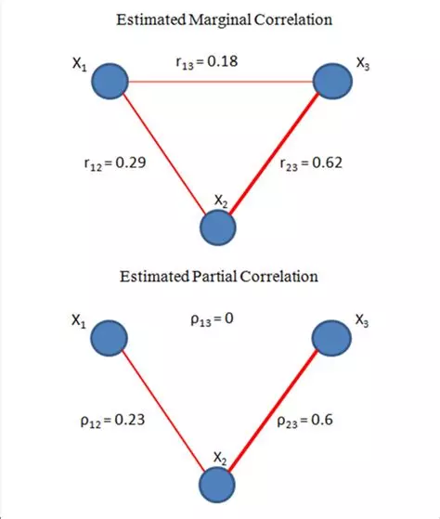
Simple = partial correlation for orthogonal (zero covariance) explanatory variables, for example, in a regression on the principal components of explanatory variables

Slide 192
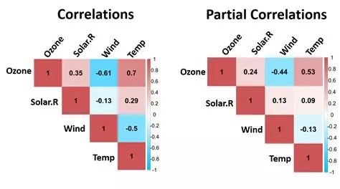
Example where simple ≠ partial correlations (PCC) for non-orthogonal regressors. PCC is OK if no high correlation among explanatory variables

Slide 193
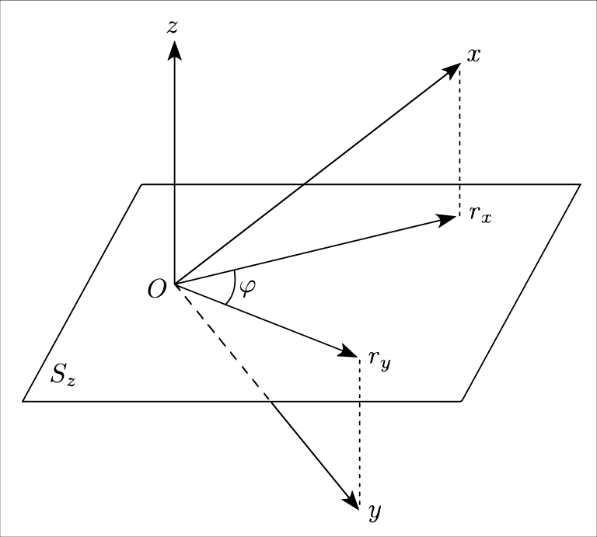
For N=3 observations, the partial correlation coefficient is the cosine of the angle φ of the residuals r_{x} and r_{y} in a plane orthogonal z⊥=S_{z} to the vector z.

Slide 194
A partial correlation coefficient is a function of t statistic and of the degrees of freedom
Dof = N-k-1≥1 with 1 for the intercept, k for the other explanatory variables and N for the number of observations. Denote r≠1 the partial correlation coefficient. Inversion of the function, with sign(t)=sign(r):
t = r. sqrt(dof)/ sqrt (1- r² )
⇔ t²/dof = 1/(-1+1/r²) ⇔1/r² = 1+dof/t²
⇔r² = t²/(t²+dof) ⇔ r = t/sqrt(t²+dof)

Slide 196
Critical region H₀: r=0 of the t test for n observations.

Slide 197
Generalization of r( y , x | Z) Yule Frisch-Waugh Lovell theorem
Instead of a single variable x, consider several variables in X:
y = Xβ + Zγ + ε ⇔ y – Zγ’ = (X – Zγ”) β + ε
Identical estimated β and same residuals ε.
y – Zγ’ are the residuals of the auxiliary regression of the dependent variables on the variables in Z.
X – Zγ” with each column is the residuals of the auxiliary regressions of each of the explanatory variables in X on the other group of explanatory variables in Z.

Slide 198
YFWL theorem is everywhere
It is equivalent to run OLS on linear transformed on Z or (not transformed variables with Z in the regression) left and right hand side (also for VAR models):
Removing the observation versus with the observation + a dummy for this observation.
On demeaned versus NOT demeaned + vector of ones.
On de-trended versus NOT de-trended + trend
On de-seasonalized versus NOT de-seasonalized + seasonal dummies.

Slide 199
When Z is the matrix of individual dummies in panel data:
The residuals is the within transformation
y_{it} – Zy_{i.} = y_{it} – y_{i.} with γ’= y_{i.} between transformation
y = Xβ + Zγ + ε ⇔ y –Zy_{i.} = (X – Z X_{i.} ) β + ε
Identical estimated β and same residuals ε.
One can either include N individual dummies (least square dummy variable LSDV) or run OLS on within transformed variables without dummies but correct degrees of freedom as NT-N-k, which is what is coded in softwares in order to avoid large N such as 1 million estimated parameters for 1 million individual dummies.

Slide 200
Partial correlation on within transformed variables
From this first stage regression ONLY on individual dummies, one obtains PARTIAL correlation coefficients and bivariate graphs,
which are the only ones RELEVANT for the second stage fixed effect estimation on OTHER within transformed explanatory variables, once all time invariant explanatory variables are included (fixed effects).

Slide 201
Partial correlation on within transformed variables
From this first stage regression ONLY on individual dummies, one obtains PARTIAL correlation coefficients and bivariate graphs,
which are the only ones RELEVANT for the second stage fixed effect estimation on OTHER within transformed explanatory variables, once all time invariant explanatory variables are included (fixed effects).

Slide 203
Partial within correlation may not correspond to your intuition
Because this intuition may be driven by individual specific (between correlation) across individuals that you know.
The extrapolation of correlation to within individual changes over time is not systematic. Cf. high CO2 emissions and intangible= zero correlation across time for within transformed data;

Slide 204
4. Within versus Between analysis of variance

Slide 205
Between transformation as the coefficients of a regression on individual dummies only
y _{it} = y_{1,.} D₁+ y _{2,.} D₂ + y _{it} –(y_{1,.} D₁+ y _{2,.} D₂)
The OLS parameters are the average over time for each individual (between transformation).
We denote the forecast (y hat): y_{1,.} D₁+ y _{2,.} D₂ = y_{i.}
y _{it} = y_{i.} +(y _{it} –y _{i.} )
The residuals of this regression only on individual dummies is the within transformation of the variable y _{it} with a zero covariance with explanatory variables. As always, residuals are orthogonal to explanatory variables.
ε_{it} = y _{it} –y _{i.} ⊥ y_{i,.} ⇔ cov(y _{it} –y _{i.} , y_{i,.} ) =0

Slide 206
Analysis of variance with OLS regression
ε_{it} = y _{it} –y _{i.} ⊥ y_{i,.} ⇔ cov(y _{it} –y _{i.} , y_{i,.} ) =0
Allows the « Analysis of variance »
⇒ V(y _{it} ) = V(y_{i.} +(y _{it} –y _{i.} ) )
= cov( y_{i.} +(y _{it} –y _{i.} ), y_{i.} +(y _{it} –y _{i.} ))
= cov( y_{i.} , y_{i.} )+cov ((y _{it} –y _{i.} ), (y _{it} –y _{i.} ))
+ 2 cov(y _{it} –y _{i.} , y_{i,.} )
= V( y_{i.})+V(y _{it} –y _{i.} )
= Variance (Between) + Variance (Within)
In the regression on individual dummies only:
0 ≤ R²= V( y_{i.}) / V(y) ≤ 1

Slide 207
Minimal panel data set N=2 (ident), T=2 (year)
IDENT | YEAR | X(it) | X(i.) | X(it)-X(i.)
1 | 1 | 8 | 10 | -2
1 | 2 | 12 | 10 | +2
2 | 1 | 5 | 4 | +1
2 | 2 | 3 | 4 | -1
ID=1 | Mean | 10 | 10 | 0
ID=2 | Mean | 4 | 4 | 0
All | Mean | 7 | 7 | 0

Slide 208
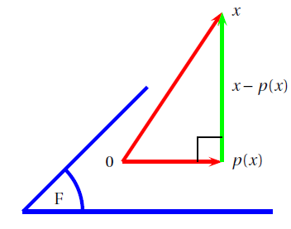
Orthogonal projection on E1=F (dimension 2) along orthogonal E2 dimension 1. F=span(col(X)).

Slide 209
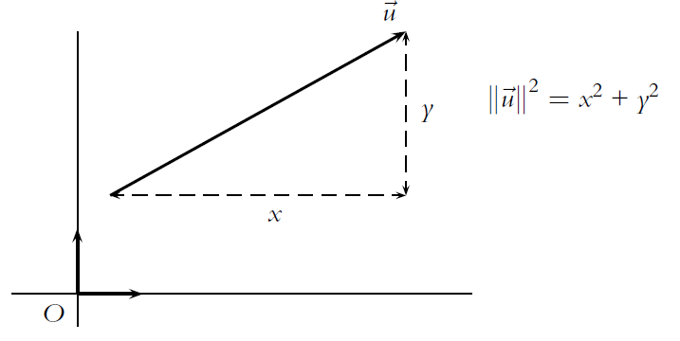
Norm of a vector u= (x,y)’ Pythagoras’ theorem

Slide 210
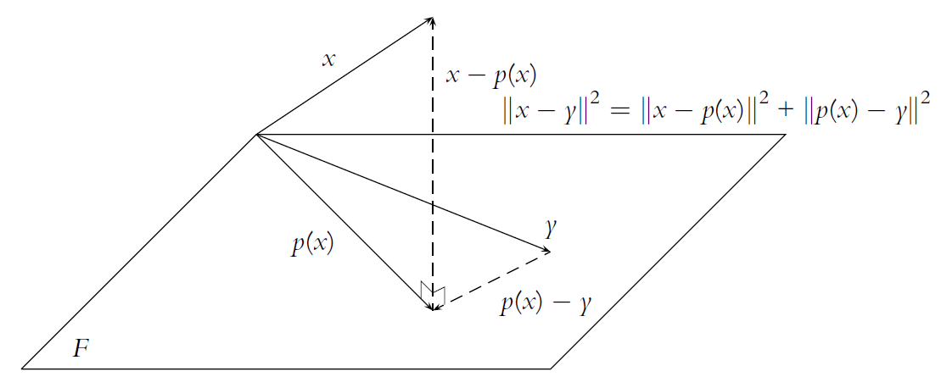
OLS: The orthogonal projection p(x) minimises the distance of x to F with respect to any other vector y in F (Pythagoras’ theorem)

Slide 211
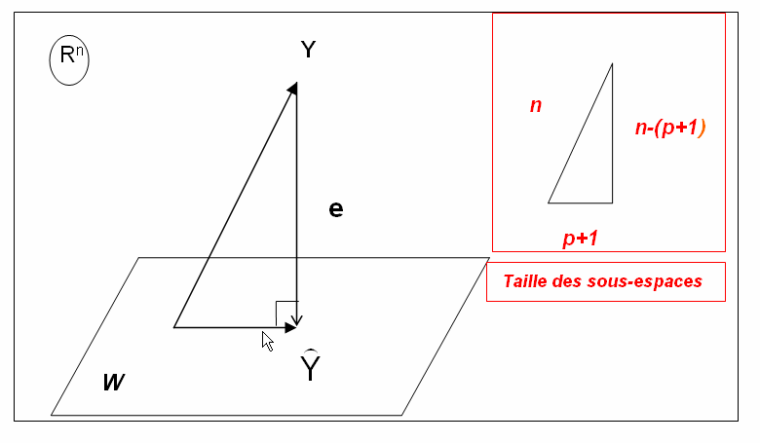
Regression: F=span(col(X)) with p columns e=y-p(x) vector of residuals.

Slide 212
Projection matrix H= X (X’X)⁻¹ X’ F=span(col(X)).
The residuals are orthogonal to each of the k column vectors of the matrix X of explanatory variables including the vector of ones. In a compact form (this corresponds to k orthogonality « normal equation » to solve for OLS parameters β):
X’ (y – Xβ ) = 0, implies X’y = X’X β
Implies β= (X’X)⁻¹ X’y if col(X) not collinear
Forecast: ^y =X β = X (X’X)⁻¹ X’ y
Orthogonal projection « Hat » matrix of the regression
H= X (X’X)⁻¹ X’ . In the case of between projection:
H = B = Z (Z’Z)⁻¹ Z’ with Z the matrix of individual dummies

Slide 213
The between transformation is an OLS regression on N individual dummies stacked in matrix Z: Orthogonal projection on F=span(col(Z)).
x(it)=B.x(it) + (I-B).x(it)= x(i.) + x(it)-x(i.)
The vector of means over time for each individual is a linear projection of a vector x(it):
x(i.) = B.x(it)
The residuals of this regression is the deviation to the individual mean over time.
x(it) - x(i.) = (I-B).x(it) = W.x(it).
The residuals are orthogonal to the forecast (the projection as best approximation):
Cov( x(i.), x(it)-x(i.) ) =0

Slide 214
Orthogonality implies the analysis of variance (Pythagoras’ theorem).
The time dimension can be written in an orthogonal (zero covariance) manner with respect to the (average of) cross-section variance.
Within group variance +
Between groups variance +
2 covariance (within, between) [=0]
= Overall variance.

Slide 215
Between transformation = an average of cross sections.
x(i,.) = average over time of observation for a given individual i.
For N individual i, there are N observations with are between transformed variables of x(i,t) which includes at most NT observations (if balanced).

Slide 216
Within transformation
Is the difference of each observation to the MEAN over time of each observation of a specific individual:
X(it)-X(i,.)
The mean over time of X(it)-X(i.) for each individual (i) is always equal to ?
Then, there are NT-N degrees for freedom.

Slide 217
With two indices: Two orthogonal worlds
The within world of time-series variation demeaned for each individual, subspace of dimension NT - N.
The between world (subspace) of the average of cross section, subspace of dimension N. Time invariant variables only vary in this world.
A perfect match when both worlds implies the same correlations is ideal. It is rarely the case.

Slide 218
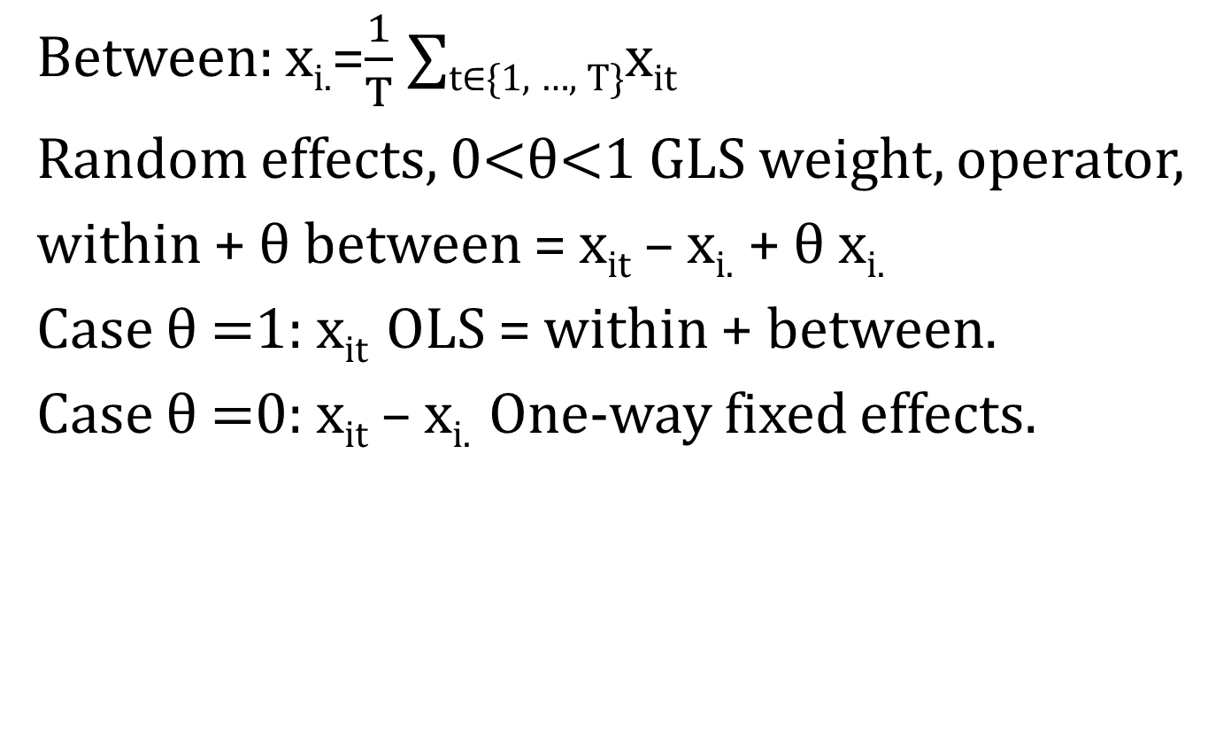
Analysis of variance operators: Between(groups) and Within(group)
Between: x_{i.}=$\frac{1}{T}$ ∑_{t∈{1, …, T}}x_{it}
Random effects, 0<θ<1 GLS weight, operator,
within + θ between = x_{it} – x_{i.} + θ x_{i.}
Case θ =1: x_{it} OLS = within + between.
Case θ =0: x_{it} – x_{i.} One-way fixed effects.

Slide 219
Analysis of variance: Orthogonal sub-spaces: Within versus Between
cov( x(it)-x(i.) , x(i.) ) = 0
Overall variance = (for example)
30% Within: deviation from this average, NT-N, Regression on within transformed variables X(it) – X(i.) = fixed effect models.
70% Between: average over time of of cross sections, dimension N = good for time invariant inference. X(i.)

Slide 220
BD: N=275: Analysis of variance
variable | variance
gdpg | 12.95207
wgdpg | 8.132692 (63%)
mgdpg | 4.8193
policy | 1.591617
wpolicy | .7358689 (45%)
mpolicy | .8557484
eda | 4.281359
weda | 1.202634 (28%) mmeda | 3.078725
Within/overall
For the dependent:
GDPG: 63% rather high
Good news for fixed effects model!
POLICY: 45%
IEDA: 28%: relatively low variance in within.
CRGE, SSA, EASIA: 0%

Slide 221
Dimension of subspaces of observations
NT = N (between) + (NT – N) (within).
Then in each subspace:
Between regression leads to an analysis of variance with prediction and residual
Within regression leads to an analysis of variance with prediction and residual

Slide 222
W/B + Forecast/residuals: 2 combined analysis of variance
Between regression analysis of variance
Y(i.) =
Forecast with X(i.) + Residuals
Within regression analysis of variance:
Y(it) – Y(i.) =
Forecast with X(it)-X(i.) + Residuals

Slide 223
Two analysis of variance: 63% within, 37% between
A fixed effect model explains « within variance » with an R2 of 15.09%
A between estimator explaines « between variance with an R2 of 57%
Both models explains 30.45% of variance:
15.09% of 63% + 57.17% of 37%
= 9.45% + 21% = 30.45%
Degrees of freedom (k=3):
NT-N-k=275-56-3=216 + N-k-1= 56-3-1=52

Slide 224
WITHIN (FIXED EFFECTS) ESTIMATION (default std err.)
R-squared = 15.09% OF 63% (share of within variance of gdpg)
= 9.45% of overall total variance of gdpg (not overwhelming)
BUT estimated parameters without alpha(i) endogeneity bias.
Root MSE = 2.6423
Estimated with « reg »: incorrect degrees of freedom for standard errors:
N.Tbar-k-1 instead of N.Tbar-N-k
----------------------------------------------------------------------------
gdpg | Coef. Std. Err. t P>|t| [95% Conf. Interval]
policy | .878318 .2087423 4.21 0.000 .4668853 1.289751
lgdp | -3.882033 1.043291 -3.72 0.000 -5.938368 -1.825698
m2_1 | -.049506 .0228887 -2.16 0.032 -.0946198 -.00439
-

Slide 225
BETWEEN ESTIMATE: N=56
WEIGHTS FOR UNBALANCED T(i) PER COUNTRY: WEIGHTED LEAST SQUARES
When Policy is the only regressor: R2=51.51%, cf square of unweighted simple correlation with gdpg (0.7091)²=r²
R2=57.17% OF 37% (THE SHARE OF BETWEEN VARIANCE IN OVERALL VARIANCE OF GDPG): 21% of OVERALL VARIANCE.
Within + Between : 15.09% of 63% + 57.17% of 37% = 9.45%+21%
Alpha(i) biased parameters.
TIME INVARIANT VARIABLES ARE NOT YET INCLUDED
RMSE= 2.572 = 1.604 x 1.604
------------------------------------------------------------------------
gdpg | Coef. Std. Err. t P>|t| [95% Conf. Interval]
-------------+----------------------------------------------------------------
policy | 1.816484 .2393748 7.59 0.000 1.336143 2.296824
lgdp | .3931539 .3101081 1.27 0.211 -.2291234 1.015431
m2_1 | .0403462 .0204063 1.98 0.053 -.000602 .0812943
_cons | -5.105835 2.233604 -2.29 0.026 -9.58789 -.6237802
------------------------------------------------------------------------------

Slide 226
6. Univariate statistics: Within vs Between (biased) Two way FE vs First differences

Slide 227
What to look for with univariate distributions graphs, statistics?
Compare skewness and kurtosis of dependent variable along with explanatory variables.
For Within transformed: plot boxplots by individuals: check large variance individuals?
Check max and min larger than 3 sigma from the mean = INFLUENTIAL OBSERVATIONS MATTERS.

Slide 228
Burnside and Dollar data
Growth rate GDP per head = first differences of ln(Y/L), average over four years, 1970-1990 (at most T=6, N=56).
EDA: aid (ODA)/GDP (received in a country)=levels, average over four years
POLICY: a linear combination of inflation, budget deficit and openness = levels
(Their paper does not use panel data estimators, although there are panel data).

Slide 229
Comparing distributions may predict the non-normality of residuals (exactly true if no other regressors)
Y –Xβ = ε NORMAL disturbances for t-test.
If X do not vary, their covariance with Y is zero and the parameter β is zero, and Y should be normal for ε to be normal.
A linear combination of normal laws is normal: if Y and X follow a normal law, then ε is normal.
Else, Y and X should have the SAME pattern of skewness and excess kurtosis, so that the residuals are not skewed and with normal kurtosis (equal to 3).
If Y is not skewed and X skewed (or conversely): the residuals will be skewed.
If Y has normal-Kurtosis (equal to 3) and X not-normal Kurtosis (or conversely): the residuals will have non normal Kurtosis.

Slide 230
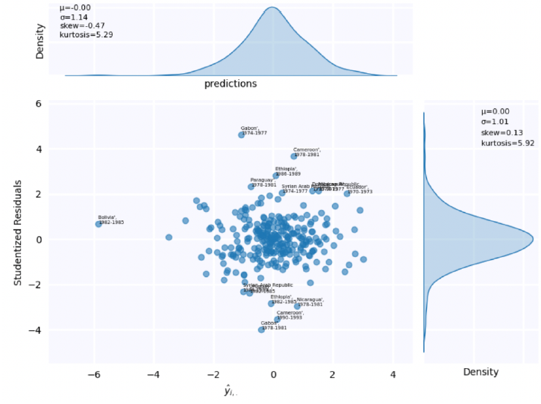
Example: Kurtosis dependent Kurtosis forecast, kurtosis residuals

Slide 231
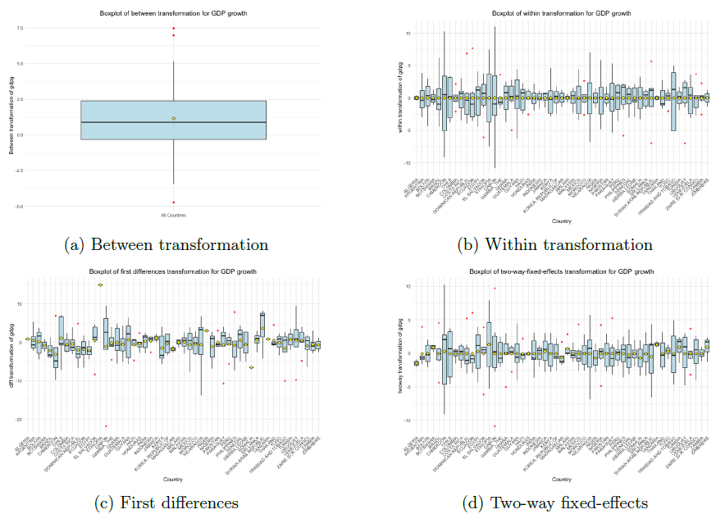

Slide 232
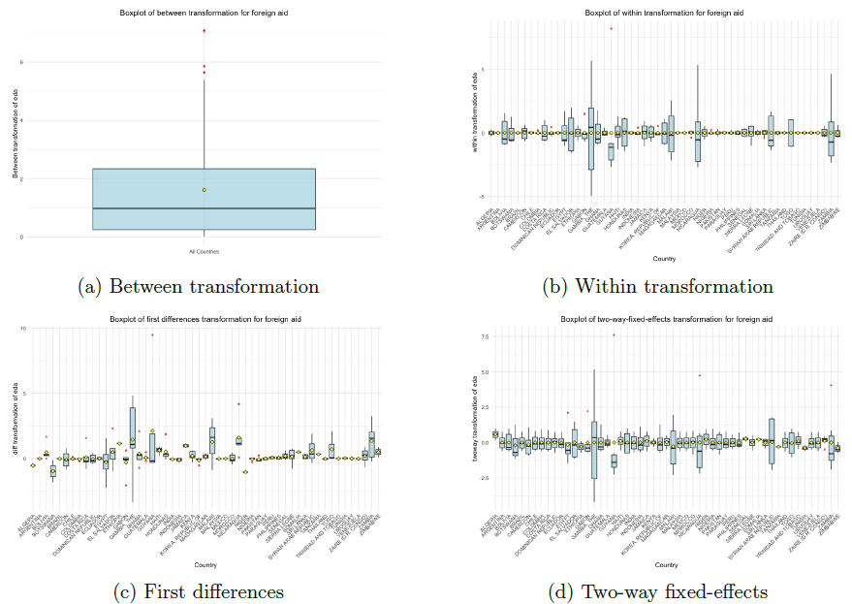

Slide 233
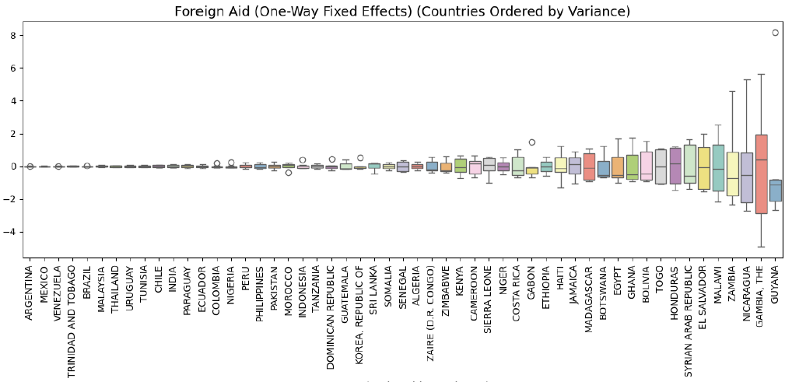

Slide 234
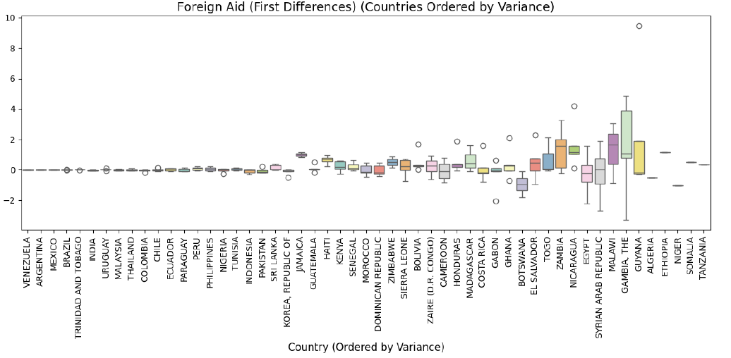

Slide 235
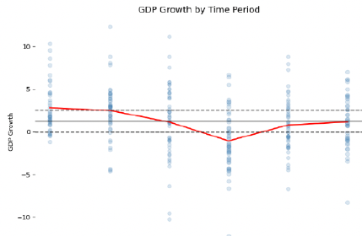

Slide 236
Comparing by country distributions within, two-way FE, FD
Most common country cases: the majority of the distributions by country of GDPG varies, whereas there is negligible variations of EDA/GDP after Within, two-way FE, FD.
Therefore, if there is non-zero correlation, it is likely to be driven by a few countries with large up and down time-variation of EDA/GDP (EDA= economic development assistance).
Within = one way fixed effects. Between = biased estimate (seen later).

Slide 237
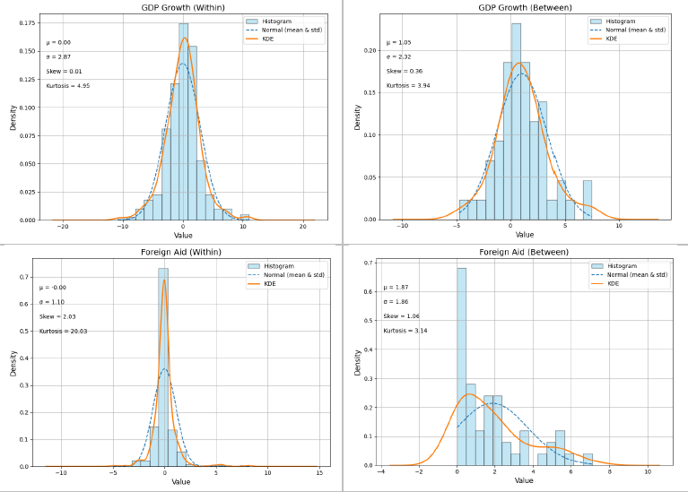

Slide 238
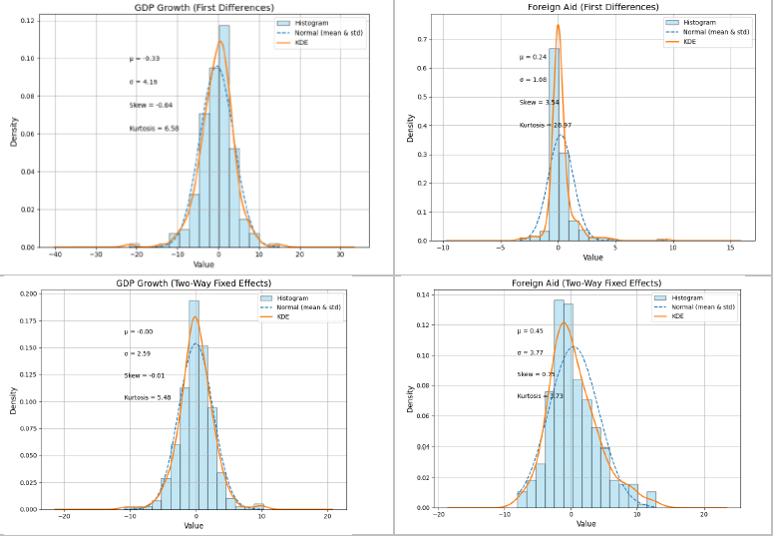

Slide 240
Within distributions « symmetry and kurtosis »
The mean is always zero, and also for sub-distributions for each individual.
The sum of above mean = the sum of below mean by individuals: the distribution are not too far from symmetry (skewness close to zero).
It is a MIXTURE (a sum) of distributions BY individuals with same mean=zero and different standard errors by individuals

Slide 241
Within: outliers, kurtosis
4. High leverage observations far above the mean for an individual are balanced by high leverage observation far below the mean for the individual. (large standard error for this individual).
5. Kurtosis, Platykurtic case: individuals for which the variable (1) did not change at all over time = time-invariant = value ZERO (2) did change very little = close to Zero.

Slide 242
Within: platykurtic: example
Average growth is a little bit over-concentrated. Usually, growth rates follow a symmetric triangular distribution, not a normal distribution.
But within ODA/GDP has a gigantic spike in zero. Large countries has small ODA/GDP, some do not change or change very little from their mean over time (note that they are already averaged over 4 years, which reduces variance).

Slide 243
Kurtosis
The « Kurtosis gap » large difference of under-kurtosis implies that ODA/GDP has not enough variance for many individuals to explain the dependent variable.
6. Kurtosis, Leptokurtic case: fat tails: happens for stock market returns for different securities.

Slide 245
Eda/gdp standardized outliers within (x_{it}-x_{i.})/sigma(sample) Within: sign symmetry by country because the sum by country of within transformed is zero
Country | Positive | Negative
Guyana | 90-93: 7.45>>2 | 74-77: -2.45 70-73: -2.19
Gambia | 86-89: 5.14>>2 90-93: 2.10 | 70-73: -4.49>>2 74-77: -3.51>>2
Nicaragua | 90-93: 4.84>>2 | 70-73: -2.47 74-77: -2.39
Zambia | 90-93: 4.21>>2 | 74-77: -2.14 etc.

Slide 246
Within correlation growth of GDP/ head and Aid/GDP: 272 observations NT-N
Symmetry on horizontal and vertical axis.
High leverage horizontal axis (ODA/GDP): observations balanced by countries left and right (GMB6, GMB2).
High leverage horizontal axis (ΔLn(GDP/L)): balanced by countries top and down (GAB3, GAB4)

Slide 247
Within correlation growth of GDP/ head and Aid/GDP: Kurtosis differences
Horizontal axis: Many observations close to zero for within transformed aid/GDP: close to the mean over time (Highly LEPTOKURTIC).
Vertical axis, Many symmetric observation more spread around the mean zero.

Slide 248
Within correlation growth of GDP/ head and Aid/GDP: Correlation
Zero correlation
No quadratic fit (only for Guyana GUY7 versus Gambia GMB3 and GUY3)
Non linear lowess fit due to « symmetric » outliers for positive growth: (only for Guyana GUY7 versus Gambia GMB3 and GUY3)
These outliers (big change over time of ODA/GDP for a given country) are NOT the same individuals than in Between.

Slide 249
Within tranformed variable: if N small, do boxplots by individuals
Compute boxplot by individuals for dependent and key explanatory variable.
Order then from largest mean to lowest mean.
Compare to boxplots of residuals by country.

Slide 250
Aid²*Policy ordered by its mean values over time per country. A few very large country-outliers

Slide 251
Boxplots (per country) of aid*policy and Aid²*Policy ordered by aid*policy(i.): only a few countries depart from « small » values

Slide 252
Between: Skewness and N<< NT-N
The distribution (average of cross section) can be very different from the within-transformed (pooled time-series demeaned by individuals).
It is often related to our « prior intuition » grounded on observations of cross-section differences, much more than fixed-effect within.
Regression is likely to have biased coefficients.

Slide 254
Between: difference of skewness (within: difference of kurtosis)
Growth rate remains symmetric in cross section, with some holes in the distribution, not far from a normal (or a symmetric triangular distribution)
ODA/GDP has a huge spike in near-zero (negligible ODA/GDP>0) and a few high positive leverage observation = extremely skewed= not normal. 8 countries out of 56 with average aid/GDP larger than 5%, around 25 countries less than 1% (skewness).

Slide 256
Between correlation growth of GDP/ head and Aid/GDP: N=56 countries.
NEGATIVE simple correlation
Quadratic fit
Non linear lowess fit = quadratic for Mali.
Large Residuals (non « symmetric ») Outliers: Botswana, Mali, Ethiopia, Korea,
8 countries out of 56 with average aid/GDP larger than 5%, around 25 countries less than 1% (skewness).

Slide 257
7. Bivariate Statistics: Within vs Between

Slide 258
Do not use the « OLS » simple correlation matrix.
Prefered model: FIXED EFFECTS (within)
The non transformed (OLS) simple correlation matrix is NOT the corresponding matrix
The WITHIN transformed correlation matrix is relevant.

Slide 259
Compare W vs B correlations
Ideally, similar WITHIN BETWEEN simple correlation between dependent and regressors, as well as similar share of variance (standard errors) in within and between dimensions.

Slide 260
Compare W vs B correlations
Would lead to identical betas in within and between, an acceptance of equality of both sets of parameters in Hausman tests constrasting Within and Between.
Then the overall variance would be fully explained by the OLS model.

Slide 263
Within correlation growth of GDP/ head and Aid/GDP: 272 observations
Zero correlation
No quadratic fit
Non linear lowess fit due to « symmetric » outliers: Gambia, Guyana, Nicaragua / Gabon = different from Between
Many observations close to zero for within transformed aid/GDP: close to the mean over time.

Slide 265
Between correlation growth of GDP/ head and Aid/GDP: 56 countries obs.
Negative simple correlation
Quadratic fit
Non linear lowess fit = quadratic.
Large Residuals (non « symmetric ») Outliers: Botswana, Mali, Ethiopia, Korea,
8 countries out of 56 with average aid/GDP larger than 5%, around 25 countries less than 1% (skewness).

Slide 266
OLS = sum between plus within
We would have a mixture of results of each worlds (Within or Between)
Outliers would be a mixture of outliers in each world (Within or between).
Within countries (time series variations)
Across (Between) countries

Slide 268
Within correlation growth of GDP/ head and Policies: 272 observations
Positive correlation: r = 0.25
No quadratic fit
Non linear lowess fit = linear
Large residuals outliers: 2 x Gabon, Comores, Nicaragua.
High leverage Bolivia (bad policy one period)
Many observations at zero/zero.

Slide 270
Between correlation growth of GDP/ head and Policies: 52 observations
Positive correlation: r=0.72 >> r=0.25 (W)
No quadratic fit
Non linear lowess fit = linear
Large residuals outliers: Egypt, Ethiopia
High leverage [far from the mean point] Botswana, Korea (Growth Miracles)
Many observations around mean point one/zero.

Slide 271
Correlation matrix diagnosis
y = a1. x1 + a2 . x2 + e
If corr (y , x1) below 0.1 in absolute value (« classical suppressor »: spurious effect identification problem): if possible, omit x1 in the regression.
If corr (x1, x2) higher that 0.8 in absolute value: near-multicolinerity problem: if possible, omit x1 OR x2 in the regression.

Slide 272
The simple correlation matrix helps to specify the multivariate model.
Helps to select regressors.
Indicates further causal or endogenous links between regressors (with their simple correlation is between 0.15 and 0.85) = this can be used for the first step of instrumental variables estimator.

Slide 273
Non zero simple correlation with dependent variable (Within):
Time trend (year) = check if unit root.
Dependent: Growth of GDP/head
Explanatory variables:
Policy
M2/GDP
Lag(Growth of GDP/head)

Slide 274
3 within transformed regressors with correlation with dependent different from zero. Correlation wM2 with trend, Autocorr wgdpg: -0.03 for 217 obs.
| year wgdpg Between wpolicy wlgdp
wgdpg | -0.2737
wpolicy | 0.1806 0.2488 ≠ 0.7091
wlgdp | 0.2887 -0.2519 ≠ 0.2787 0.0543
wm2_1| 0.5588 -0.1816 ≠ 0.2116 0.0179 0.2009

Slide 275
Gdp growth is the first difference of log of gdp per head: persistence of gdp per head is wiped out by first differences. In this sample, its auto-correlation is close to zero: no dynamic model necessary. No long term interpretation of between.
No very large correlations (>0.8) with trend: within may not be subject to spurious time series correlation.
The between / within discrepancy may be related to cov(x(i.), alpha(i) ) endogeneity bias for between.

Slide 278
Zero simple correlation with dependent variable (Within):
Time trend (year) = check if unit root.
Dependent: Growth of GDP/head
Explanatory variables:
Aid/GDP
Aid/GDP * Policy
Aid/GDP* Aid/GDP * Policy

Slide 279
Poorly correlated (<0.1) with dependent (and highly correlated together): spurious parameter identification problem if not robust to outliers: spurious
| year wgdpg weda wedapol weda2plcy wassas
-------------+---------------------------------------------------------------
weda | 0.3601 0.0079
wedapolicy | 0.1748 0.0883 0.4488
weda2policy | 0.1383 0.0428 0.5147 0.9273
wassas | 0.0761 -0.0592 0.0306 0.0162 -0.0020
wethnfassas | 0.0296 -0.0219 -0.0003 -0.0070 -0.0088 0.8821

Slide 280
| wgdpg between weda wedapolicy
weda | 0.0079 -0.3417
wedapolicy | 0.0883 0.1866 0.4488 0.5912
weda2policy | 0.0428 0.0858 0.5147 0.6225 0.9273 0.9229
Parameter identification problem
Check robustness to outliers

Slide 283
Zero correlation with dependent
Growth of GDP/head
Assassinations
Assassinations * ethnic fractionalization
The product of variables is called an « interaction term »

Slide 286
wgdpg between wassas
wassas | -0.0592 -0.0690
wethnfassas | -0.0219 -0.0656 0.8821 0.8315
WITHIN = BETWEEN for correlations in this case = IDEAL case
Interaction term highly correlated with one of its component.

Slide 287
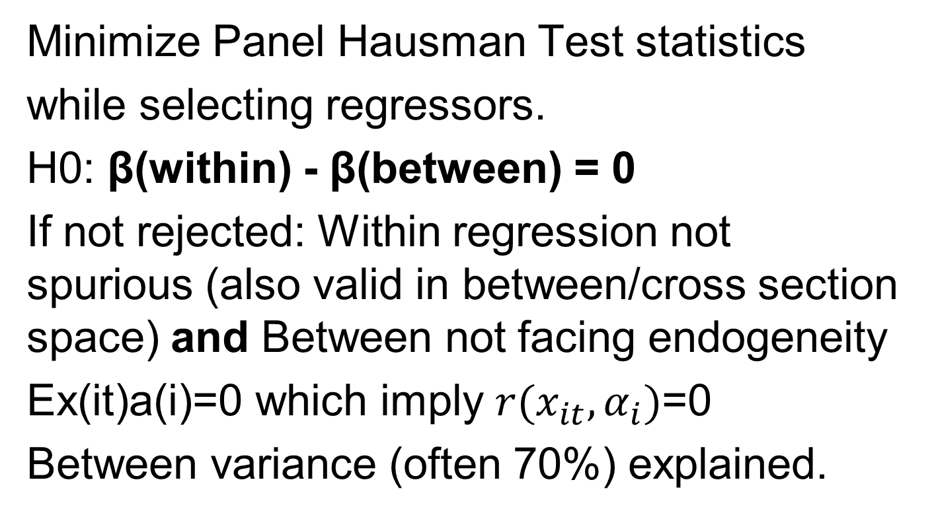
Ideally: Specification minimizing the gap Within versus Between (sub-correlation matrix W = B) Between parameters face endogeneity bias, not within.
Minimize Panel Hausman Test statistics
while selecting regressors.
H0: β(within) - β(between) = 0
If not rejected: Within regression not spurious (also valid in between/cross section space) and Between not facing endogeneity
Ex(it)a(i)=0 which imply $r(x_{it},α_{i})$=0
Between variance (often 70%) explained.

Slide 288
8. Group (i) heteroscedasticity GLS « random effects ».

Slide 289
Group (i) heteroscedasticity
Check the distribution of the residuals of a pooled OLS regression, for example with boxplots:
Pooled residuals.
Pooled residuals BY individuals

Slide 291
Boxplots of studentized residuals per country (i): (i)-heteroskedasticity

Slide 292
Visualizing individual (i) heteroskedascity?
If N<50, it is recommended to plot boxplots of residuals per-individuals, SORTING them either by means or by their standard errors.
Although ALL the residuals have mean zero.
The means of residuals PER individuals are not ZERO. The standard errors of residuals PER individuals are DIFFERENT.

Slide 293
Studentized residuals (OLS influence statistics)
Their are divided (scaled) by a standard error measure. They may follow a Student’s law.
You may notice when the box plot crosses the line -2 and the line +2 as a signal for outlier (with excessive residual).

Slide 294
Group (i) – Hetero-skedasticity
The variance-covariance matrix of disturbances is a specific block-diagonal matrix, each block corresponds to an individual (i).
This leads ot a specific generalized least square (GLS) estimator, the Random effect model (1966).

Slide 295
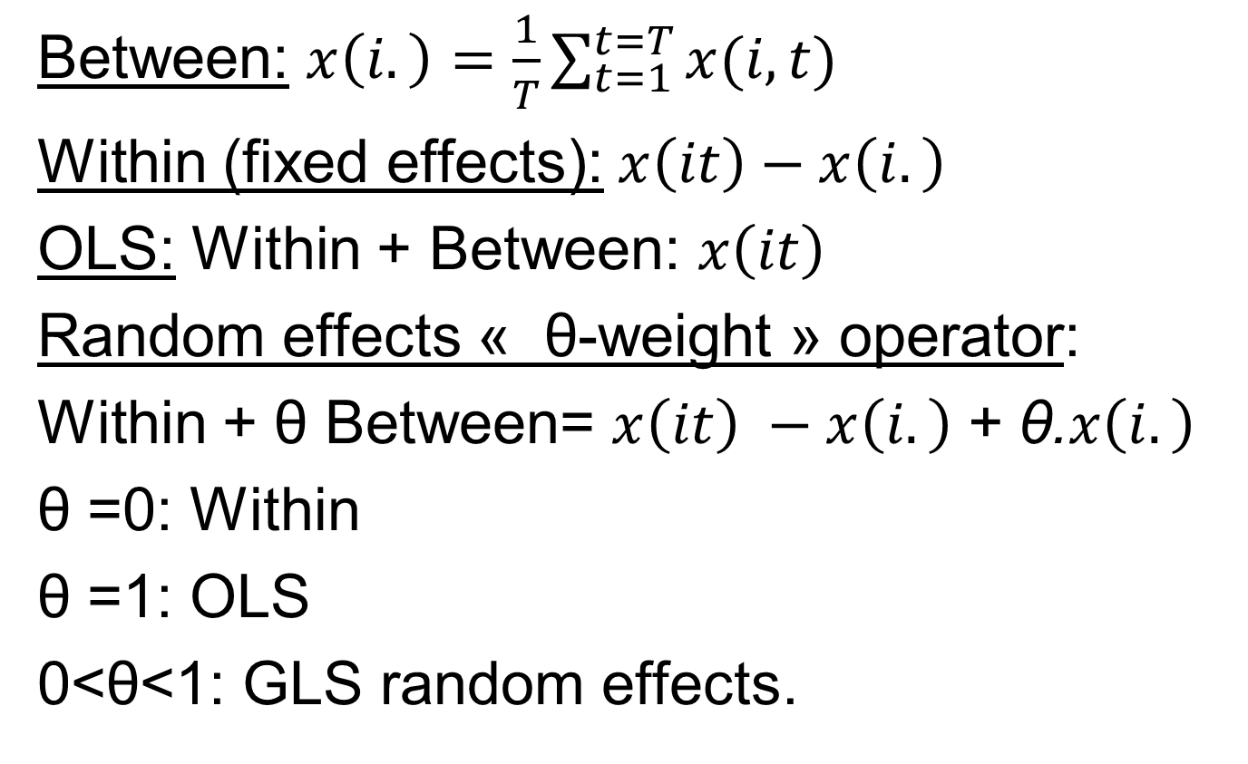
Analysis of variance operators: Between(groups) and Within(group)
Between: $x\left(i.\right)=\frac{1}{T}\sum_{t=1}^{t=T}{x(i,t)}$
Within (fixed effects): $x\left(it\right)−x\left(i.\right)$
OLS: Within + Between: $x\left(it\right)$
Random effects « θ-weight » operator:
Within + θ Between= $x\left(it\right) −x\left(i.\right)$+ θ.$x\left(i.\right)$
θ =0: Within
θ =1: OLS
0<θ<1: GLS random effects.

Slide 296
Coded Random Effects
It is coded in softwares (xtreg re on STATA, etc.)
You do not need to recode estimates of theta (with one method: Swamy Arora for example) and create GLS-transformed variables.

Slide 297
Does GLS changes the shape of the residuals distributions?
The non-zero means and the different standard errors remains.
These distinct components of heteroskedasticity are not corrected for. Heteroskedasticity has many shapes (one outlier is heteroskedasticity).
But the GLS estimated parameters changes with respect to OLS.

Slide 298
GLS Random effects with distinct standard error for each individuals
To begin with, the GLS random effects model assumes a time-invariant variance component with identical theoretical variance for all.
In addition, what we have seen is that this time-invariant variance may differ from one individual to another in boxplots for the gasoline demand model.

Slide 299
What if distinct time-invariant variance across individuals?
The first way to handle in addition distinct time-invariant is to ask for clustered standard errors by individuals.
It can be possible to define a distinct weight 0<θ(i)<1: GLS random effects.
But this refinement is not so useful because the « random effects » model is under-performing with respect to fixed effects or Mundlak model

Slide 300
9. Hausman Pre-Test of E(α(i)|X(it)) for then testing either fixed effects OR random effects.

Slide 301
The IV Hausman test applied on FE (IV) – RE(non-IV)
Null hypothesis= zero difference of all parameters of FE (IV estimator ruling out α(i) disturbance) minus RE( non-IV estimator with may be biased due to α(i) endogeneity).
It the differences are large, this suggests there is an endogeneity bias and the IV estimator is to be preferred. (Remark: You may have endogeneity without endogeneity bias).

Slide 302
Visual Hausman test of each difference of parameters in proportion of parameters
. hausman fixed ., sigmamore
Coefficients (b) (B) (b-B) sqrt(diag(VarCovar(b)-VarCovar(B))
fixed effects random effects Difference Std. err.
age -.005485 -.0069749 0.0014899 .0004803
msp .0033427 .0046594 -.0013167 .0020596
ttl_exp .0383604 .0429635 -0.0046031 .0007181
b = Consistent under H0 and Ha; obtained from xtreg.
B = Inconsistent under Ha, efficient under H0; obtained from xtreg.
Test of H0: Difference in coefficients not systematic (RE=FE)
Weighted by covariance sum of squares of the differences of 3 parameters
chi2(3) = (b-B)'[(VarCovar(b)-VarCovar(B))⁻¹](b-B)
= 260.40 >>0
Prob > chi2 = 0.0000 < 5%, reject the null hypothesis which favour the random effects (RE=FE) = Hausman pre-test suggests using FIXED EFFECTS.

Slide 303
Hausman pre-tests an observed endogeneity BIAS of estimated parameters.
NOTE: a variable may be endogenous and parameters without endogeneity bias: endogeneity MAY create a bias.
Foreign aid/ GDP and growth (Burnside and Dollar pooled OLS regression):
Zero correlation before and after IV.
Foreign aid/GDP is endogenous with re.

Slide 304
Outcome of Hausman pre-test RE versus FE
Usually, there is a difference of the parameters RE versus FE, which rejects the null hypothesiss of RE=FE.
⇒ The Hausman test statistics (sum of squares of differences of parameters weighted by the inverse of their variance covariance matrix) is far from zero, which rejects the null.
⇒ RE is rejected and FE chosen.

Slide 305
Hausman (1978) test: OLS vs IV, RE vs FE.
It is proposed to do a Hausman pre-test (in practice a post-test) for Random effects (without all x(i.)) versus Fixed effects.
Guggenberger (Journal of econometrics): Hausman pre-test is misleading. For « SMALL » endogeneity (corr(x(it),alpha(i) <0.25), it over accepts « random effects », but the endogeneity bias is LARGE.

Slide 306
Time-Invariant regressors
In fact, RE only survives because it allows time-invariant regressors to remain in the regression
But there is Mundlak specification: RE provides FE estimates and keeps time-invariant regressors with very different parameter estimates.
And Hausman Taylor regression.

Slide 307
9. Group (i) endogeneity Mundlak and fixed effects

Slide 308
« Fixed effects » Model Three equivalent estimators
Random effect (RE) GLS adding N X(i.) variables: Mundlak (1978) specification.
Within (Fixed effects GE): OLS estimation on within transformed variables, with NT–N-k degrees of freedom.
OLS estimation with N dummies for each individual with specific intercept: Least Square Dummy Variables (LSDV), with NT–N-k degrees of freedom.

Slide 309
9.1. Mundlak

Slide 310
WITHIN (FIXED EFFECTS) ESTIMATION (default std err.)
R-squared = 15.09% OF 63% (share of within variance of gdpg)
= 9.45% of overall total variance of gdpg (not overwhelming)
BUT estimated parameters without alpha(i) endogeneity bias.
Root MSE = 2.6423
Estimated with « reg »: incorrect degrees of freedom for standard errors:
N.Tbar-k-1 instead of N.Tbar-N-k
----------------------------------------------------------------------------
gdpg | Coef. Std. Err. t P>|t| [95% Conf. Interval]
policy | .878318 .2087423 4.21 0.000 .4668853 1.289751
lgdp | -3.882033 1.043291 -3.72 0.000 -5.938368 -1.825698
m2_1 | -.049506 .0228887 -2.16 0.032 -.0946198 -.00439
-

Slide 311
Minimal panel data set N=2 (ident), T=2 (year)
IDENT | YEAR | X(it) | X(i.) | X(it)-X(i.)
1 | 1 | 8 | 10 | -2
1 | 2 | 12 | 10 | +2
2 | 1 | 5 | 4 | +1
2 | 2 | 3 | 4 | -1
ID=1 | Mean | 10 | 10 | 0
ID=2 | Mean | 4 | 4 | 0
All | Mean | 7 | 7 | 0

Slide 312
Individual – Endogeneity: Fixed effect IV estimator
With panel data regressions, there is a potential PARTICULAR type of « individual(i) time-invariant » endogeneity
= NON ZERO covariance of explanatory variables with ALL individual-(i) time-invariant omitted variables characteristics included in the disturbances.
With leads ot a PARTICULAR type of INSTRUMENT VARIABLES estimator called « IV fixed effect or Within model ».

Slide 313
α(i)-endogeneity BIAS for β1 and β0
y(it)=β0+β1.x(it)+α(i)+α(t)+ε(it)
Cov(x(it), α(i)) = 0 or not.
α(i): individual (time invariant) unobserved random effects (characteristics).
Country: geography, history before the beginning of the sample, and so on.
Cov(x(it), ε(it)) = 0 or not: may also exist, but it is set aside as being less important.

Slide 314
Mundlak: GLS and IV Heteroskedasticity and endogeneity
Mundlak assumes a PARTICULAR linear α(i)-endogeneity model:
α(i)=β2.x(i.) +β3.z(i) +β’0+α’(i)
Random effects including all averages over time of time varying variables x(i.) in the set of regressors (Mundlak estimator).
y(it)=β1.x(it)+β2.x(i.)+β3.z(i) +β’0+ β0
+α’(i)+α(t)+ε(it)

Slide 315
Mundlak is not coded in R, stata and others
How do I run it? Two steps:
1) I compute the average over time for each individual of all time-varying regressors (PROC MEANS x(it) BY individuals, in SAS)
x(i.)
2) I run the RANDOM EFFECT model listing explanatory variables: x(it), x(i.), z(i)

Slide 316
GLS versus IV Random versus Fixed effects
A long standing debate since 1966 has been how to choose between the GLS (Random effects) VERSUS the IV (fixed effects) model, or the random effect versus the fixed effect model. However the debate has been settled by Mundlak (1978) and Hausman’s test (1978). In practice, Fixed effects = Random effects à la Mundlak (1978) > Random effects without X(i.)

Slide 317
Properties of Mundlak estimator
(1) It is a random effect estimator which provides the SAME estimates for the parameters of x(it)
than the fixed effect (or within) estimator!
(2) It is marginally interesting if one intends to have an « index of endogeneity of variables x(it) » which corresponds to the parameter of x(i.), which is a difference of between versus within estimates.
(3) And it is VERY USEFUL for the estimated parameters of time-invariant regressors z(i)

Slide 318
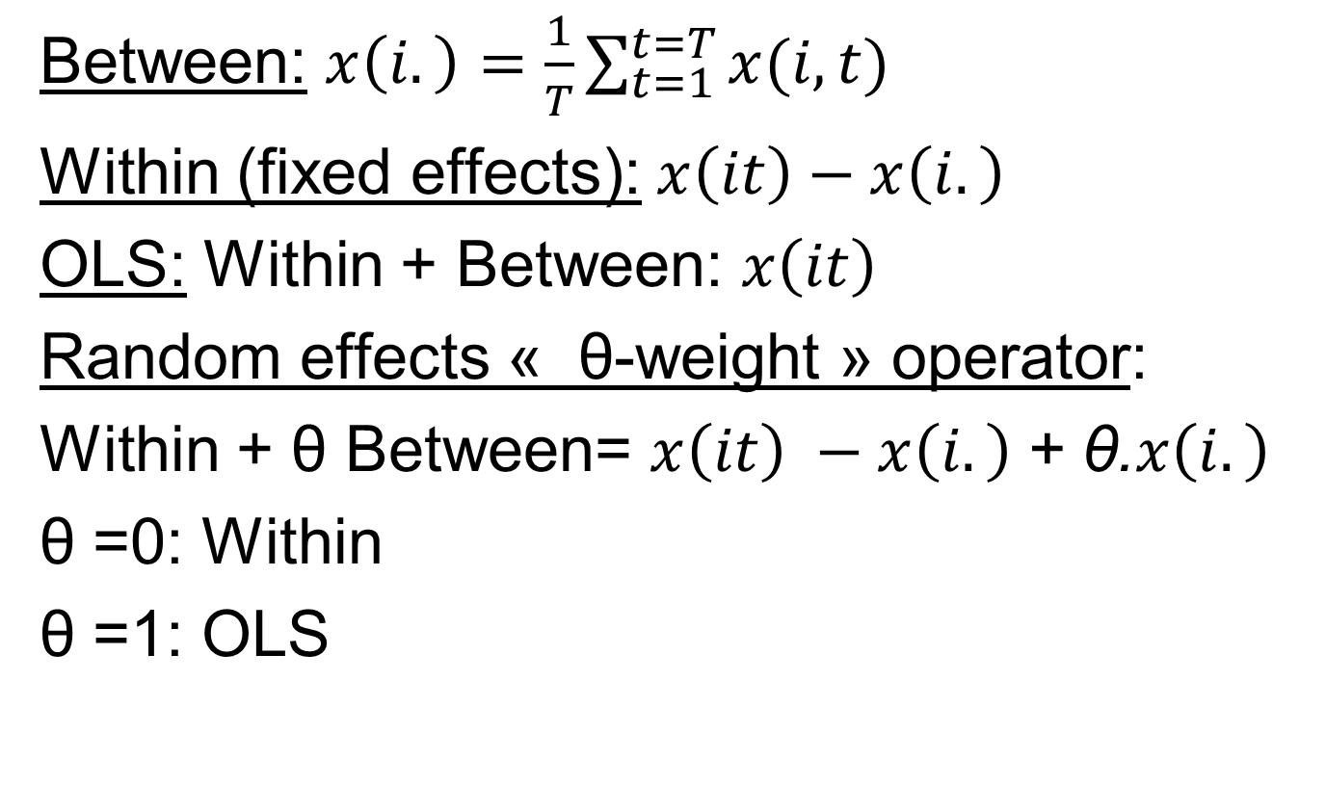
Analysis of variance operators: Between(groups) and Within(group)
Between: $x\left(i.\right)=\frac{1}{T}\sum_{t=1}^{t=T}{x(i,t)}$
Within (fixed effects): $x\left(it\right)−x\left(i.\right)$
OLS: Within + Between: $x\left(it\right)$
Random effects « θ-weight » operator:
Within + θ Between= $x\left(it\right) −x\left(i.\right)$+ θ.$x\left(i.\right)$
θ =0: Within
θ =1: OLS

Slide 319
9.2. LSDV, small N = 9.3 due to Frisch Waugh

Slide 320
Least square dummy variables LSDV
OLS estimates on slopes on non-within transformed regressors but including dummies for all individuals (estimates N constants for N individuals)
= OLS on within transformed (2nd method).
Demonstration: a property of Frish Waugh theorem, also used for seasonal dummies.

Slide 321
Multivariate panel estimators
Fixed effects: OLS on within transformed
Two way fixed effects: add time dummies;
Between: OLS on between transformed.
Random effects: OLS on
Within transformed + theta * between.
Mundlak: Random effects including all x(i.) and z(i)
OLS on First differences (with T=2: identical to fixed effects, different when T>2).

Slide 322
Advice
If no time invariant regressor: use fixed effects: random effects with X(i.) > random effects without X(i.).
If time invariant regressor, use Mundlak specification (random effects with X(i.) ) > random effects without X(i.).
Then use other IV and GMM estimators. Xtivreg, Xtabond2 (GMM ONLY IF T<10!!)

Slide 323
If common trends for dependent and regressors
Insight from simple correlation with trend
and auto-correlation.
Then, also add in your tables:
Between estimation.
First differences estimation (prefered one before IV estimation): degrees of freedom = 1st period disappears: (T-1)N observations

Slide 324
9.3. FE (Within)

Slide 326
Xtreg fe: a 2nd way to compute fixed effects
The software code programs:
OLS on within transformed variables (theta=0 with respect to GLS without x(i.)).
It corrects degrees of freedom: NT – N – k instead of NT – k – 1.

Slide 330
Within estimator: NT-N-k=N(T-1)-k
OLS on within transformed variables:
NT-N-k degrees of freedom (dof)
>> cross section and between dof N-k-1, time series dof T-k-1
Number of regressors excluding intercept : k
The intercept is always zero, because within transformed dependent variable and regressors have all zero mean.

Slide 331
Within as an IV estimator: Eliminates α(i) endogeneity
y(i,t)=β(cst)+β(x).x(i,t)+α(i)+α(t)+ε(i,t)
The operator between leads to:
y(i,.)=β(cst)+β(x).x(i,.)+α(i)+ε(i,.)
The difference eliminates α(i), the β(cst) constant and all time invariant regressors z(i) in the sample period, the average over time of α(t) may be chosen as zero:
y(it)-y(i,.)=β(x).(x(it)-x(i,.))+α(t)+ε(it)-ε(i,.)

Slide 332
Trend hence unit root with within transformed data
If the conditional expectation of the time random effect is linear with time: α(t)= b.t
(may be also quadratic):
Then the one-way fixed effects (on individuals only) will face unit root and potential common trends correlation with explanatory variables.

Slide 333
Non stationarity of Within transformed variables
Within transformed variables eliminate
cov (x(it) , a(i) ) BUT:
Common trends remains even with T<10:
spurious regressions, trend driven near-multicollinearity.
Compare with first differences and between estimators.

Slide 334
Two way fixed effects and first differences
If the conditional expectation of the time random effect is linear with time: α(t)= b.t
(may be also quadratic):
Then the two-way fixed effects (on dates and individuals) will estimate b.
When two-way FE estimated parameters differ A LOT from one-way FE estimated parameters: common trend may matter.

Slide 335
First difference eliminates α(i) and ALSO unit roots
y(i,t)=β0+β(x).x(i,t)+α(i)+α(t)+ε(i,t)
y(i,t-1)=β0+β(x).x(i,t-1)+α(i)+α(t-1)+ε(i,t-1)
The first differences eliminates α(i), the intercept β0 and all time invariant variables z(i) in the sample:
y(it)-y(i,t-1)=β(x).(x(it)-x(i,t-1))+ε(it)-ε(i,t-1)+
α(t)-α(t-1)

Slide 336
Hierarchy
Cross section (endogeneity + omitted variables z(i))
<<< Fixed effects with common slopes restriction for N individuals. (NT-N-k) degree of freedom better for inference than time series with T too mall, even not doable with T<k+1.
<<< N times series regressions with different slopes, doable if N small (N<20) and T>70 or 100 for inference (10 observations for each explanatory variable (say 7 to 10) for power of t-test).

Slide 337
Cross section < fixed effects < time series different slopes
Number of explanatory variables k | T small<k+1 or <70 observations weak inference for time series | T large>100
N very small: 2 to 20<100 | Macro, yearly, OECD. FIXED EFFECTS degrees of freedom: NT-N-k>T-k-1. | Prefer 20 time series regressions with different slopes
N large >100 | Balance sheets, surveys. FIXED EFFECTS NT-N-k>T-k-1. | Market finance FIXED EFFECTS NT-N-k>T-k-1.

Slide 338
TWFE transformation for univariate and bivariate statistics.
For balanced panel: add the average time series
–x(.t)+x(..) to the within transformation:
x(it)-x(.i)-x(.t)+x(..)
For unbalanced panel: residuals of the regression of a within transformed variable on all time dummies.
For unbalanced panel with too many time dummies: code Wansbeek Kapstein (1989) matrices transformation

Slide 339
TWFE and multiple treatments at different dates (diff in diff).
De Chaisemartin et d’Haultfoeuille (2022) published several papers in the recent years on corrections to be done using the TWFE.

Slide 340
10. Between explanation of between variance

Slide 341
BETWEEN ESTIMATE: N=56
WEIGHTS FOR UNBALANCED T(i) PER COUNTRY: WEIGHTED LEAST SQUARES
When Policy is the only regressor: R2=51.51%, cf square of unweighted simple correlation with gdpg (0.7091)²=r²
R2=57.17% OF 37% (THE SHARE OF BETWEEN VARIANCE IN OVERALL VARIANCE OF GDPG): 21% of OVERALL VARIANCE.
Within + Between : 15.09% of 63% + 57.17% of 37% = 9.45%+21%
Alpha(i) biased parameters.
TIME INVARIANT VARIABLES ARE NOT YET INCLUDED
RMSE= 2.572 = 1.604 x 1.604
------------------------------------------------------------------------
gdpg | Coef. Std. Err. t P>|t| [95% Conf. Interval]
-------------+----------------------------------------------------------------
policy | 1.816484 .2393748 7.59 0.000 1.336143 2.296824
lgdp | .3931539 .3101081 1.27 0.211 -.2291234 1.015431
m2_1 | .0403462 .0204063 1.98 0.053 -.000602 .0812943
_cons | -5.105835 2.233604 -2.29 0.026 -9.58789 -.6237802
------------------------------------------------------------------------------

Slide 342
BETWEEN Including 4 time invariant variables
R2=59.07% > 57.17%: marginal gain of R2 = 2%
ICRGE no longer relevant regressor (inference with N=56).
------------------------------------------------------------------------------
gdpg | Coef. Std. Err. t P>|t| [95% Conf. Interval]
-------------+----------------------------------------------------------------
policy | 1.661274 .3073901 5.40 0.000 1.043224 2.279323
lgdp | -.1287407 .482766 -0.27 0.791 -1.099407 .8419255
m2_1 | .0301945 .0222294 1.36 0.181 -.0145006 .07488
icrge | .2697856 .2305179 1.17 0.248 -.1937016 .7332728
ssa | -.8900755 .8002408 -1.11 0.272 -2.499067 .7189164
easia | .128337 .9851497 0.13 0.897 -1.852439 2.109113
ethnf | -.0020761 .009249 -0.22 0.823 -.0206726 .0165203
_cons | -1.571956 3.541679 -0.44 0.659 -8.69298 5.549067
------------------------------------------------------------------------------

Slide 343
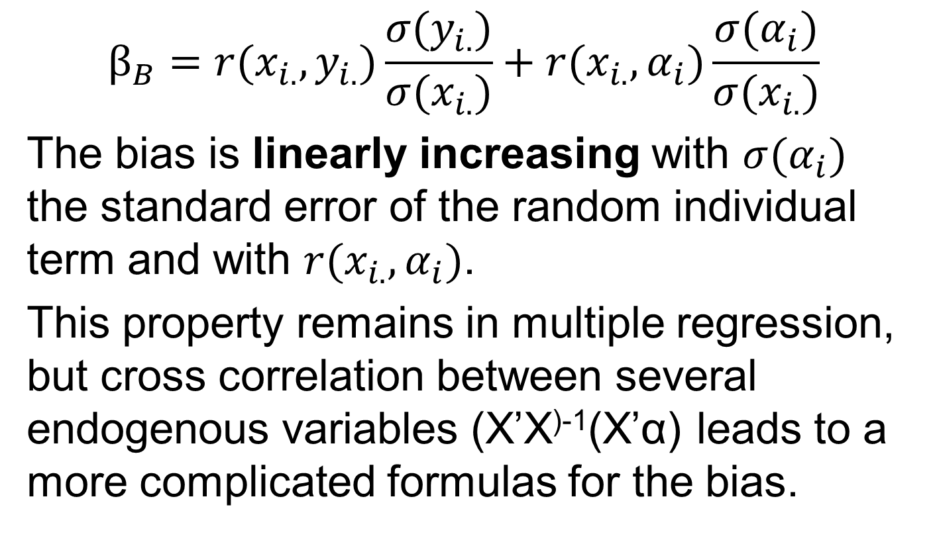
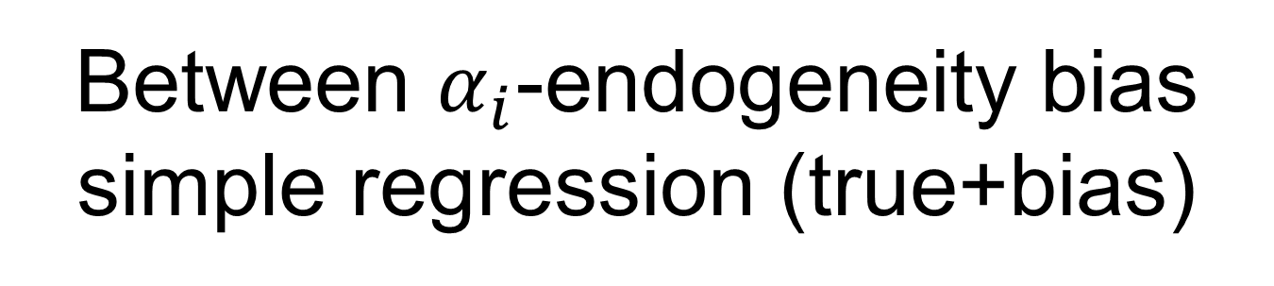
Between $α_{i}$-endogeneity bias simple regression (true+bias)
$$β_{B}=r(x_{i.},y_{i.})\frac{σ(y_{i.})}{σ(x_{i.})}+r(x_{i.},α_{i})\frac{σ(α_{i})}{σ(x_{i.})}$$
The bias is linearly increasing with $σ(α_{i})$ the standard error of the random individual term and with $r(x_{i.},α_{i})$.
This property remains in multiple regression, but cross correlation between several endogenous variables (X’X⁾⁻¹(X’α) leads to a more complicated formulas for the bias.

Slide 344
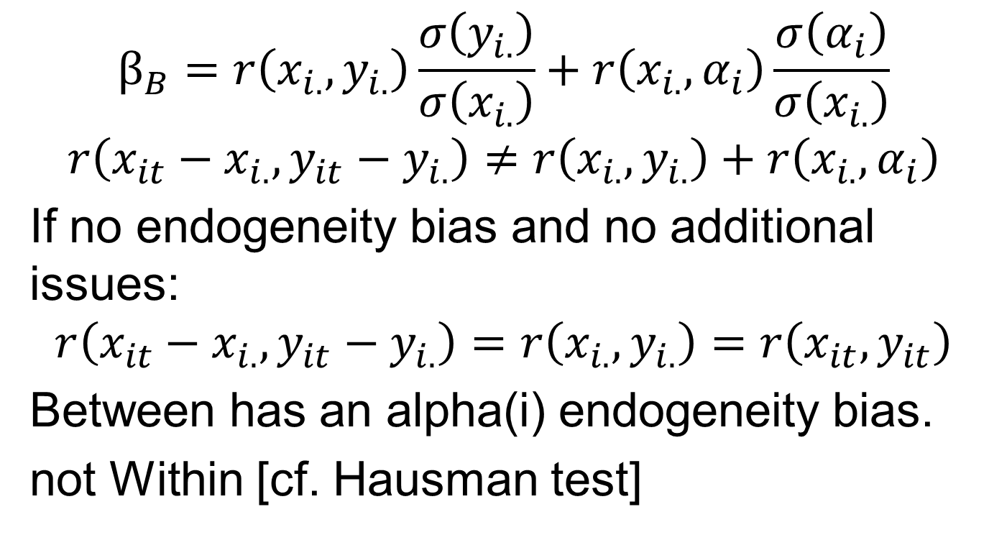
Within vs Between
$$β_{B}=r\left(x_{i.},y_{i.}\right)\frac{σ\left(y_{i.}\right)}{σ\left(x_{i.}\right)}+r\left(x_{i.},α_{i}\right)\frac{σ\left(α_{i}\right)}{σ\left(x_{i.}\right)}$$
$$r\left(x_{it}−x_{i.},y_{it}−y_{i.}\right)≠r\left(x_{i.},y_{i.}\right)+r\left(x_{i.},α_{i}\right)$$
If no endogeneity bias and no additional issues:
$$r\left(x_{it}−x_{i.},y_{it}−y_{i.}\right)=r\left(x_{i.},y_{i.}\right)=r\left(x_{it},y_{it}\right)$$
Between has an alpha(i) endogeneity bias.
not Within [cf. Hausman test]

Slide 345
Between weaknesses with respect to Within
Faces individual (i) endogeneity bias = it is set aside most of the time (except when showing bivariate correlation).
Has N-k-1 < NT – N – k degrees of freedom, hence lower t-stats.

Slide 346
Between strengths with respect to Within
30% to 70% of the variance of the dependent variable with « relevance ».
Eliminates trends and spurious regressions due to unit roots, not FE.
A « good » long run estimator of a model with lagged dependent variable, FE biased.
Includes time-invariant regressors.

Slide 347
Dynamic model: Between as a long term estimate
When the true model has an auto-regressive component = DYNAMIC MODEL.
AND when there is no alpha(i) endogeneity.
Between estimate converges to long term
beta/(1-autoreg parameter)
[hence within may be smaller in absolute value than between parameters]
Pirotte (Economics Letters)

Slide 348
xttab ssa, time-invariant sub-saharan africa dummy
Overall Between Within
ssa | Freq. Percent Freq. Percent Percent
----------+-----------------------------------------------------
0 | 191 69.45 35 62.50 100.00
1 | 84 30.55 21 37.50 100.00
----------+-----------------------------------------------------
Total | 275 100.00 56 100.00 100.00
(n = 56)

Slide 349
Repeated data: Z(i), X(i,.) in the database
Ident (for individual) | YEAR | Z(i) | X(i.) | X(it)
1 | 1 | 8 | 50 | 48
1 | 2 | 8 | 50 | 52
2 | 1 | 200 | 20 | 21
2 | 2 | 200 | 20 | 19

Slide 350
Copy T times the same data and run a regression
You have a sample with Y(i) and X(i)
You run a simple regression.
You copy T=20 times the same sample
Does the cloud of points « changes » ?
Does the regression line changes ?
Do the degrees of freedom changes?
Do the standard errors of the estimated parameters changes ?

Slide 351
Coded Between estimator
The coded between estimator in softwares:
Uses OLS on between transformed variables in the table.
Corrects the degrees of freedom to be
N-k-1 and not NT – k - 1

Slide 352
Repeated Between has meaningless degrees of freedom
Repeated T times x(i.) is what appears in your database of dimension NT when you compute it.
STATA: xtreg y x, be
Adjusted for dof = N – k -1
STATA: reg y(i.) x(i.)
Dof NT-k-1, artificial increase of t stats.

Slide 353
11. Time-invariant regressors: Mundlak estimation

Slide 354
Panel data with time-invariant variables
Geographical distance for cross-country data in gravity models of foreign trade and foreign direct investments (Egger and Pfaffermayr (2004), Serlenga and Shin (2007),…
Years of schooling, gender and race when testing Mincer’s wage regressions using survey data (Hausman and Taylor (1981)).
Colonial or legal origin, initial GDP/head in 1960 for growth or income or inequality (GINI) regressions.

Slide 355
Individual invariant Z(t)
Time trend,
World indicators for country aggregate X(it)
Country indicators for firm, sectors, bank or households level data X(it).

Slide 356
Time invariant regressors
time-invariant regressors can ONLY change BETWEEN Variance. They are eliminated in LSDV and Fixed effect Within estimation.
Their degrees of freedom for inference is N not NT
Random effect estimates of parameter for z(i) (omitting Mundlak x(i.)) are COMPLETELY different once x(i.) are included in random effect à la Mundlak

Slide 357
Mundlak (1978): run RANDOM effects including ALL x(i.)
ASSUME: a(i)=b’.X(i.)+c’.Z(i)+a’(i)
Y(it) = bw X(it) + (bb-bw) X(i.)
+ cb. Z(i) + a’(i) + e(it)
Correct degrees of freedom (N-k-1) for Z(i) for balanced panel.

Slide 358
Influence statistics not coded for fixed effects?
If you run OLS INCLUDING x(i.): you find the same parameters than Mundlak RE !
But the standard errors are not correct.
This helps for influence statistics such as DF-befas computed for OLS but sometimes not for Fixed effects.

Slide 359
Mundlak estimator: beta (B) – beta (W), beta(B) for time invariant: FOR BALANCED PANEL (weights in between for unbalanced?)
------------------------------------------------------------------------------
gdpg | Coef. Std. Err. z P>|z| [95% Conf. Interval]
-------------+----------------------------------------------------------------
policy | .878318 .2079318 4.22 0.000 .4707792 1.285857
lgdp | -3.882033 1.03924 -3.74 0.000 -5.918907 -1.845159
m2_1 | -.049506 .0227999 -2.17 0.030 -.0941929 -.004819
mpolicy | .413422 .3574066 1.16 0.247 -.2870822 1.113926
mlgdp | 3.606534 1.125934 3.20 0.001 1.399744 5.813323
mm2_1 | .0766954 .0304941 2.52 0.012 .016928 .1364628
icrge | .470856 .2050086 2.30 0.022 .0690466 .8726655
ssa | -1.1797 .7126032 -1.66 0.098 -2.576376 .2169769
easia | .5661284 .8568978 0.66 0.509 -1.11336 2.245617
ethnf | -.002012 .0084419 -0.24 0.812 -.0185578 .0145339
_cons | -.811913 3.231572 -0.25 0.802 -7.145679 5.521853
-------------+----------------------------------------------------------------
sigma_u | .60621529
sigma_e | 2.9596021
rho | .04026596 (fraction of variance due to u_i)
------------------------------------------------------------------------------

Slide 360
Outliers: studentized residuals of the Mundlak regression
OLS provides residuals and fitted for Mundlak (SE of parameters are not correct).
Influence statistics

Slide 365
12: Hausman Taylor estimator for α(i)-endogenous time invariant regressors

Slide 366
Mundlak then Hausman Taylor coded in Stata
Mundlak corrects Cov(x(it),α(i)) adding X(i.) variables in random effects.
This corrects omitted variables X(i.) bias on the parameter of Z(i) in random effects.
But what is: Cov(z(i),α(i)):
Education level z(i) is correlated with individual (i) time-invariant specificities?

Slide 367

Z(i): endogeneity bias for slope γ simple regression (2nd term)
$$γ=r(z_{i},y_{i.})\frac{σ(y_{i.})}{σ(z_{i})}+r(z_{i},α_{i})\frac{σ(α_{i})}{σ(z_{i})}$$
The bias is linear with the standard error of the random individual term and increases with r(z(i), alpha(i)).
In multiple regression, cross correlation between several endogenous variables (X’X⁾⁻¹(X’α) leads to a more complicated formulas for the bias.

Slide 368
Hausman and Taylor estimator
It deals with the alpha(i) endogeneity of time invariant variables:
Corr ( z(i), alpha(i) )
Strong assumption:
We know that at least one of the x(i.) is exogenous and can be used as instrument for z(i), while we know the other x(i.) are endogenous.

Slide 369
Weaknesses of HT
A pre-test may look at the Mundlak test
bb-bw for the x(i.): t<2: x(i.) exogenous.
2. Check if weak instrument: R2 of correlation of exogenous X(i.) with Z(i).
3. Multiple comparisons. In the returns of education example in stata doc. for HT estimations: there are k=9 X(i.) for 1 variable to instrument, the number of combinations is very large (C,1,9).

Slide 370
Mundlak Pretest of exogeneity
Y(it) = βw. X(it) + (βb- βw). X(i.)
+ γb. Z(i) + α(i) + ε(it)
If H0: (βb- βw)=0 not rejected, X(i.) is exogenous with respect to a(i).
Below, mpolicy may be an instrument of icrg measure of corruption.

Slide 371
Mundlak estimator: beta (B) – beta (W), beta(B) for time invariant: FOR BALANCED PANEL (weights in between for unbalanced?)
------------------------------------------------------------------------------
gdpg | Coef. Std. Err. z P>|z| [95% Conf. Interval]
-------------+----------------------------------------------------------------
policy | .878318 .2079318 4.22 0.000 .4707792 1.285857
lgdp | -3.882033 1.03924 -3.74 0.000 -5.918907 -1.845159
m2_1 | -.049506 .0227999 -2.17 0.030 -.0941929 -.004819
mpolicy | .413422 .3574066 1.16 0.247 -.2870822 1.113926
mlgdp | 3.606534 1.125934 3.20 0.001 1.399744 5.813323
mm2_1 | .0766954 .0304941 2.52 0.012 .016928 .1364628
icrge | .470856 .2050086 2.30 0.022 .0690466 .8726655
ssa | -1.1797 .7126032 -1.66 0.098 -2.576376 .2169769
easia | .5661284 .8568978 0.66 0.509 -1.11336 2.245617
ethnf | -.002012 .0084419 -0.24 0.812 -.0185578 .0145339
_cons | -.811913 3.231572 -0.25 0.802 -7.145679 5.521853
-------------+----------------------------------------------------------------
sigma_u | .60621529
sigma_e | 2.9596021
rho | .04026596 (fraction of variance due to u_i)
------------------------------------------------------------------------------

Slide 372
Variation of Hausman Taylor
Default does not includes X(i.) as regressors.
You may include the X(i.) which are not exogenous (mlgdp and mm2 in the example)
But you should NOT include X(i.) which are used as instruments, because of near-multicollinearity with the instrumented Z(i) .

Slide 373
13: TWO WAY FIXED EFFECTS tranformation: X(it) - X(i.) - X(.t) + X(..) Fellow of X(i,t) - X(i,t-1)

Slide 374
Fixed effects for individuals and for time: different options
OLS including dummies for individuals AND for years (or time index) but no common intercept and one year removed (else exact collinearity).
Fixed effects: « two-way » option.
OLS on transformed variables (dot is for average of each indices [wrong degrees of freedom for standard errors]:
X(it)-X(i.)-X(.t)+X(..)

Slide 375
Properties
Bivariate graphs on transformed data:
Y(it) - X(i.) - X(.t) + X(..)
X(it) - X(i.) - X(.t) + X(..)
Provides the relevant insight for remaining effects of X on Y in two way regression.
Degrees of freedom for regression:
NT – N – T + 1 – k, when the number of explanatory variables is equal to k.

Slide 376
Two way fixed effects may explain « too much » of R2
The R2 of a regression with only fixed and time effects may be relatively large.
The remaining explanatory variables may add very little to this R2.

Slide 377
14: lagged dependent variable (ARDL dynamic panel) First differences Anderson Hsiao (1981). GMM panel for T<10 and N large

Slide 378
Auto-regressive distributed lag model (ARDL), cf. time series.
y_{i,t} = β_{y} y_{i,t-1} + β₁ x_{i,t} + β₂ x_{i,t-1} + α_{i} + α_{t} + ε_{it}
|β_{y}| < 1 (test unit root with panel data unit root tests)
Impulse response function for 1 unit change of x:
t=1: β₁
t=2: β_{y} β₁ + β₂
t=3: β_{y} ² β₁ + β_{y}β₂
t=4: β_{y} ³ β₁ + β_{y} ² β₂

Slide 379
ARDL long run coefficient (cf. time series)
Sum until infinity over all the impulse responses for all periods of a converging geometric series:
β_{LT} = ( β₁ + β₂) / (1 - β_{y} )
Without autoregressive term: classic numerical example:
β₁ =1.4 (larger than a unit root), β₂ = -0.5 (opposite sign)
β_{LT} = β₁ + β₂ = 1.4 - 0.5 = 0.9 (lower or close to a unit root).
The standard error of the estimated parameter β_{LT} can be computed by the so-called « delta method ».

Slide 380
ARDL and Error correction model
There exist an extension of cointegration to panel data due to Pedroni.
An ARDL model can always be rewritten as an error correction model (see time series courses).

Slide 381
Single column X(i,t) Lag operator does not work
Once you have a single column for all individuals: This is STACKED time series.
You need to have special code for the LAG operator: why? Try a 2x2 example.
Example stata: xt command for all panel data instructions

Slide 382
Lag and Dif operator: requires mentioning two indices
Ident | Year | X(it) | Lag(X(t)) time series | Lag(X(it)) =X(i,t-1) Stacked Panel
1 | 1 | 8 | Dot (not available). | Dot (not available)
1 | 2 | 12 | 8 | 8
2 | 1 | 5 | 12 | Dot (not available)
2 | 2 | 3 | 5 | 5

Slide 383
Several tests of unit roots for panel data
Xtunitroot (Stata)
The Levin–Lin–Chu (2002), Harris–Tzavalis (1999), Breitung (2000; Breitung and Das 2005), Im–Pesaran–Shin (2003), and Fisher-type (Choi 2001) tests have as the null hypothesis that all the panels contain a unit root.
The Hadri (2000) Lagrange multiplier (LM) test has as the null hypothesis that all the panels
are (trend) stationary.

Slide 384
Nickell (1981) bias of lagged dependent variable with fixed effects
This theoretically demonstrated bias of the estimated parameter of the lagged dependent variable is
large for small T<10
decreases with T
is negligible for large T>30 or even T>20.

Slide 385
DO the Anderson Hsiao (1981) whatever the value of T.
First differences (computed in PANEL, taking into account the change of individual: check the output of your first differences at the change of individuals)
For all the variables of the model (Δ α_{i} =0)
Δ y_{i,t} = β_{y} Δ y_{i,t-1} + β₁ Δ x_{i,t} + β₂ Δ x_{i,t-1} + Δ α_{i}
+ Δ α_{t} + Δ ε_{it}
Instrumented (IVREG) by lagged levels (or lagged differences) for all variables or AT LEAST the lag Instrumented (Ivreg) by lagged levels (or lagged ged dependent variable, instrumented by y_{i,t-2} or lagged first differences y_{i,t-2} -y_{i,t-3} (you lose 1 period of estimation with the additional t-3)

Slide 386
First differences (and two way within fixed effect) transformation.
Eliminates cross section endogeneity
For example, temperature is related to time-invariant geographic characteristics.
(2) Eliminate deterministic trend and unit roots.
For example, temperature has a deterministic upward trend.

Slide 387
Each time you add a lag for the specification or the instrument
You lose one additional observation (date) for the regression in time series.
For panel data, your lose the full cross section of this lost period: N.1
If N=1 million observations, you remove 1 million observations.
Therefore, researcher prefer to instrument
Δ y_{i,t-1} by y_{i,t-2} instead of Δ y_{i,t-2} (in order to save one period)
They keep the first difference instrument for robustness checks. Surprisingly, the estimates may not differ a lot when instrumenting in levels or in first difference if one uses the same period of estimation.

Slide 388
Descriptive statistics should be done on the sample of estimation:
For all these variables:
Δ y_{i,t} Δ y_{i,t-1} Δ x_{i,t} Δ x_{i,t-1} y_{i,t-2} x_{i,t-2}
For univariate statistics (mean median standard error, skewness, kurtosis, min max).
For bivariate simple correlation coefficients:
The correlation between Δ y_{i,t-1} Δ x_{i,t} Δ x_{i,t-1}
and y_{i,t-2} x_{i,t-2} is a preliminary check for weak or strong instruments.

Slide 389
Strength
Correct endogeneity bias in fixed effect for lagged dependent variable large when T<10, small when T>30.
Corrects endogeneity bias for all other explanatory variables and their lags.
With IVREG, you have also ALL the first stage regressions that you can show and discuss if your IV is a weak instrument.

Slide 390
ARDL Anderson Hsiao (1981)
You can plot the impulse response functions.
You have to compute the long run coefficients.
Sometimes the estimated parameter of the lagged dependent variable is around 1/3,
The long run coefficient denominator effect multiplies the sum of short run coefficients by 3/2 = 1.5
β_{LT} = ( β₁ + β₂) / (1 - β_{y} ) = 1.5 ( β₁ + β₂).

Slide 391
Additional issues
Can I add dummies for each period: yes.
Can I add dummies for each quarter to handle seasonality: yes.
Can I winsorise data in level then take first differences: better to take FIRST first differences and then winsorise (cap data to an upper percentile value when it is above this percentile to handle extreme values; from a statistician named Winsor).

Slide 392
What about the first differences of a dummy variable?
If D_{i,t} shift from 0 to 1:
Δ D_{i,t} =1 – 0 = 1
If D_{i,t} remains 0 to 0 or 1 to 1:
Δ D_{i,t} =0 – 0 = 1-1 = 0
If D_{i,t} shift from 1 to 0:
Δ D_{i,t} =0 – 1 = -1
Therefore, it has three values (-1, 0, 1).

Slide 393
14B: The rise and fall of GMM dynamic panel data estimator

Slide 394
You should report the NUMBER of instruments in your tables
It is not worth reading a paper
which uses GMM for panel which does not report the number of instruments for each regression, besides
the number of observations NT,
the number of individuals N
the average number of time dimension per individual NT/N.

Slide 395
For T<10 only, GMM first differences and GMM system
GMM FD panel uses all available lags in LEVELS:
Period 10 (last): lag2 to lag 10 (8 instruments)
Period 9: lag2 to lag9 (7 instrument for 1 variable)
Period 8: lag2 to lag8 (6 instruments for 1 variable)
Total: 36 instruments times K variables.
It uses too many instruments which are highly correlated together and with a weak correlation with the variables to be instrumented.
No first stage regression is available from the softwares to check for weak instruments.

Slide 396
Trade-off for lags as instrumental variables
The more remote the lag(t-m), the less it is correlated with current disturbances at date t: it is « more » exogenous.
However, it is less correlated to the explanatory variable x(t) to be instrumented: it is « weaker ».
And if all the other earlier lags are also used, its partial correlation contribution to the explanatory variable is even smaller (weaker) than used alone.

Slide 397
Arrelano Bond (1989) GMM first differences
Their idea was to improve the efficiency of Anderson Hsiao (1981) using ALL available lags.
In 1989, they focused only on exogeneity pre-test using Sargan test= over-identifying restriction test = J-test. Then remote lags always improved the exogeneity tests of the set of instruments.
Around 2000, the literature woke up again with weak instrument tests (not only for panel data), including Kleinberger Paap test, Stock-Yogo test: this paved the way to destroy slowly the credibility of GMM FD.

Slide 398
You may be happy when rejecting the null or sometimes when not rejecting the null.
When having to apply a new test, check what is the null hypothesis and check what is the outcome of the test which is helpful for you in your study:
Reject the null (p<5%): You enjoy parameters different from zero or different between groups, means to be different between groups, rejecting unit roots.
Do not reject the null (p>5%): You enjoy normality, the exogeneity of the instruments E(Xε), you may enjoy unit root (auto-correlation equal to one) for co-integration.

Slide 399
Happiness criterion
 | Test | Do not reject the null p>5% | Reject the null p<5%
y=βx+ε | Student | β=0 | Happy: « effect »
x1 and x2 | Student | m1=m2 | Happy: difference.
x(t)=βx(t-1)+ε(t) | Unit root | β=1 | |β|<1, Happy stationary
x normal | Sktest-chi2 Kolmogorov, etc. | x normal: Happy | x not normal
Exogenous instruments, GMM panel | Sargan=J=over-idenitifying restrictions | E([x(t-1),x(t-2)],ε)=0 Happy | Endogenous instruments: fail.
My instruments are better than OLS? | Hausman IV with Chi2 | β(OLS)=β(IV) Choose OLS. | β(OLS)=β(IV)+bias: choose IV: happy
Panel fixed effects (particular IV) > random effects | Hausman IV with Chi2 | β(RE)=β(FE) Choose RE | β(RE)=β(FE)+bias: choose FE: happy

Slide 400



Slide 401
p<0.05 (t>2 or t<-2) versus p>0.05 and 0≤X²<X²(5%) threshold
For Student’s « t-test » on parameters: researchers enjoys REJECTING the null that parameters are zero: H0: β=0 with
p-value=proba(type 1 error)
=proba(rejecting H0 | H0 true)<0.05.
For Chi-2 tests, (independance, normality or exogeneity H0: E(x.ε)=0): researchers often enjoys NOT REJECTING the null hypothesis (p>0.05 and X²< threshold)

Slide 402
Sargan test
xtabond — Arellano–Bond linear dynamic panel-data estimation. After xtabond, estat sargan reports the Sargan test of overidentifying restrictions.
. estat sargan
H0: Overidentifying restrictions are valid
chi2(25) = 65.81806 (for 25 instruments), relatively FAR from zero, measuring the distance to the null hypothesis.
Prob > chi2 = 0.0000 <<<5% (p-value below 5%).
⇒ STRONG EVIDENCE AGAINST THE NULL hypothesis that the instruments of this regression are exogenous.
⇒ You are UNHAPPY because you need to try another set of instruments.
(Once, a candidate for a position in Paris1 interpreted all her Sargan tests the other way round in her job market paper).

Slide 403
Difference of Sargan test (due to Hansen)
You need to have a subset A of instrument which is very exogenous (you need a Sargan pre-test).
Then you test if the additional instrument B can be added for form the sub-set A⋃B.
BUT if your subset A includes some very endogenous instrument, you will accept to add another endogenous instrument B in the family A⋃B.
So be CAUTIOUS, those tests are automatically proposed in Stata interverting A and B WITHOUT pre-testing ifs A or B is exogenous.

Slide 404
GMM system doubles the number of equations and of instrumetns
GMM system:
Instrument first differences by lagged levels
(GMM first differences).
AND
Instrument levels by lagged first differences.

Slide 405
Weaknesses of GMM
Weak instruments: If unit root but not only, lagged levels are weakly correlated with first differences and conversely.
Exogeneity test biased with too many instruments (instruments are counter by period: m lags x T-3 periods x k explanatory variables with lags+ 1 lagged dependent variables) : 800 instruments for NT=1000 observations may happen.
A (weak) rule of thumb is that the number of instruments should be at least below N. But what is N N=1 million…

Slide 406
Weaknesses continued
Doing multiple testing with multiple sets of lagged instrument leads to a stream of highly unstable parameter estimates varying widely.
Anybody can find any value of the parameters (which is practical for publication bias).
At the end, you really do not understand what is happening, as the software does not provide first stage estimations (as in IVREG) for weak instruments.

Slide 407
GMM Success decade 2000 with multiple testing without Bonferroni correction.
After Gauss version, David Roodman coded xtabond2 for Stata.
Widely used at World Bank and in academia.
P-Hacking by multiple comparisons (multiple testing) using many combinations of instruments without dividing the 5% threshold by the number of trials (Bonferroni correction). The usual practice was up to several hours of trial and errors.

Slide 408
The decline of GMM panel fashion
Roodman published « too many instruments ».
Research in development shifted to controlled experiments fashion.
Focus on alternative methods and estimators seeking other IV or improving differences in differences for causal factors.
You may try for robustness checks with respect to Anderson Hsiaoh, but the fashion is over. SELECT the option of GMM with the SMALLEST number of instruments.

Slide 409
David Roodman
Roodman, D. (2009). How to do xtabond2: An introduction to difference and system GMM in Stata. The stata journal, 9(1), 86-136.
(11500 citations, 09/2023 G Scholar)
Roodman, D. (2009). A note on the theme of too many instruments. Oxford Bulletin of Economics and statistics, 71(1), 135-158.
(5600 citations, 09/2023 G Scholar)

